Slide 1
Homework Assignment 0
Due Thursday (Midnight Baltimore Time)

Slide 2
Add yourself to the course website on Github
Due Thursday (Midnight Baltimore Time)
0. Download these slides at
1. If you do not already have a Github account, create one at https://github.com/
2. Fork the class repo https://github.com/JEFworks-Lab/genomic-data-visualization-2023
3. Clone the repo to your computer
4. Add a profile picture under the /profiles/ as [jhed].jpg
5. Create a profile for yourself under the /_authors/ folder as [jhed].md
6. Commit and push your local changes to your Github
7. Make a pull request to submit this assignment and merge your changes back to the class repo

Slide 3
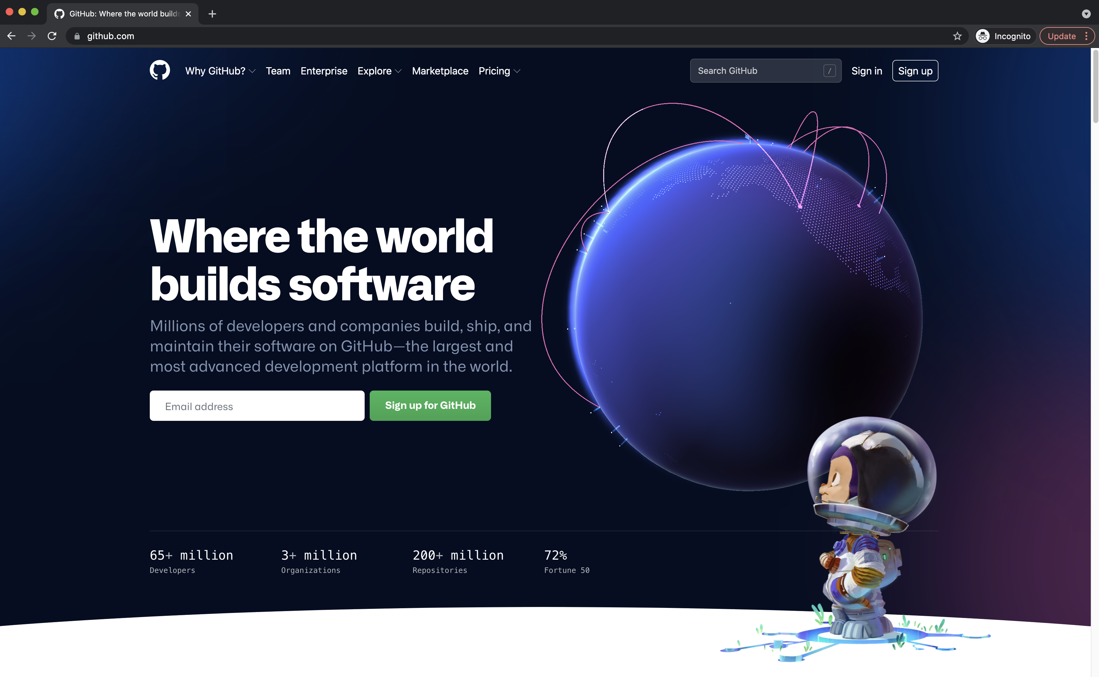
1. If you do not already have a Github account, create one at https://github.com/

Slide 4
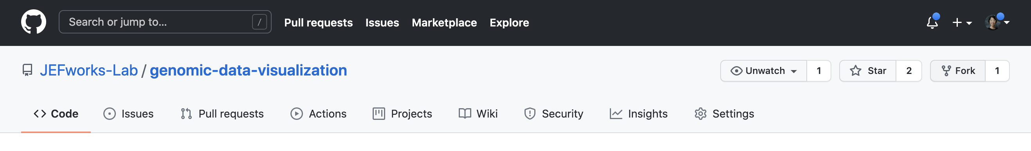
2. Fork the class repo https://github.com/JEFworks-Lab/genomic-data-visualization-2023

Slide 5
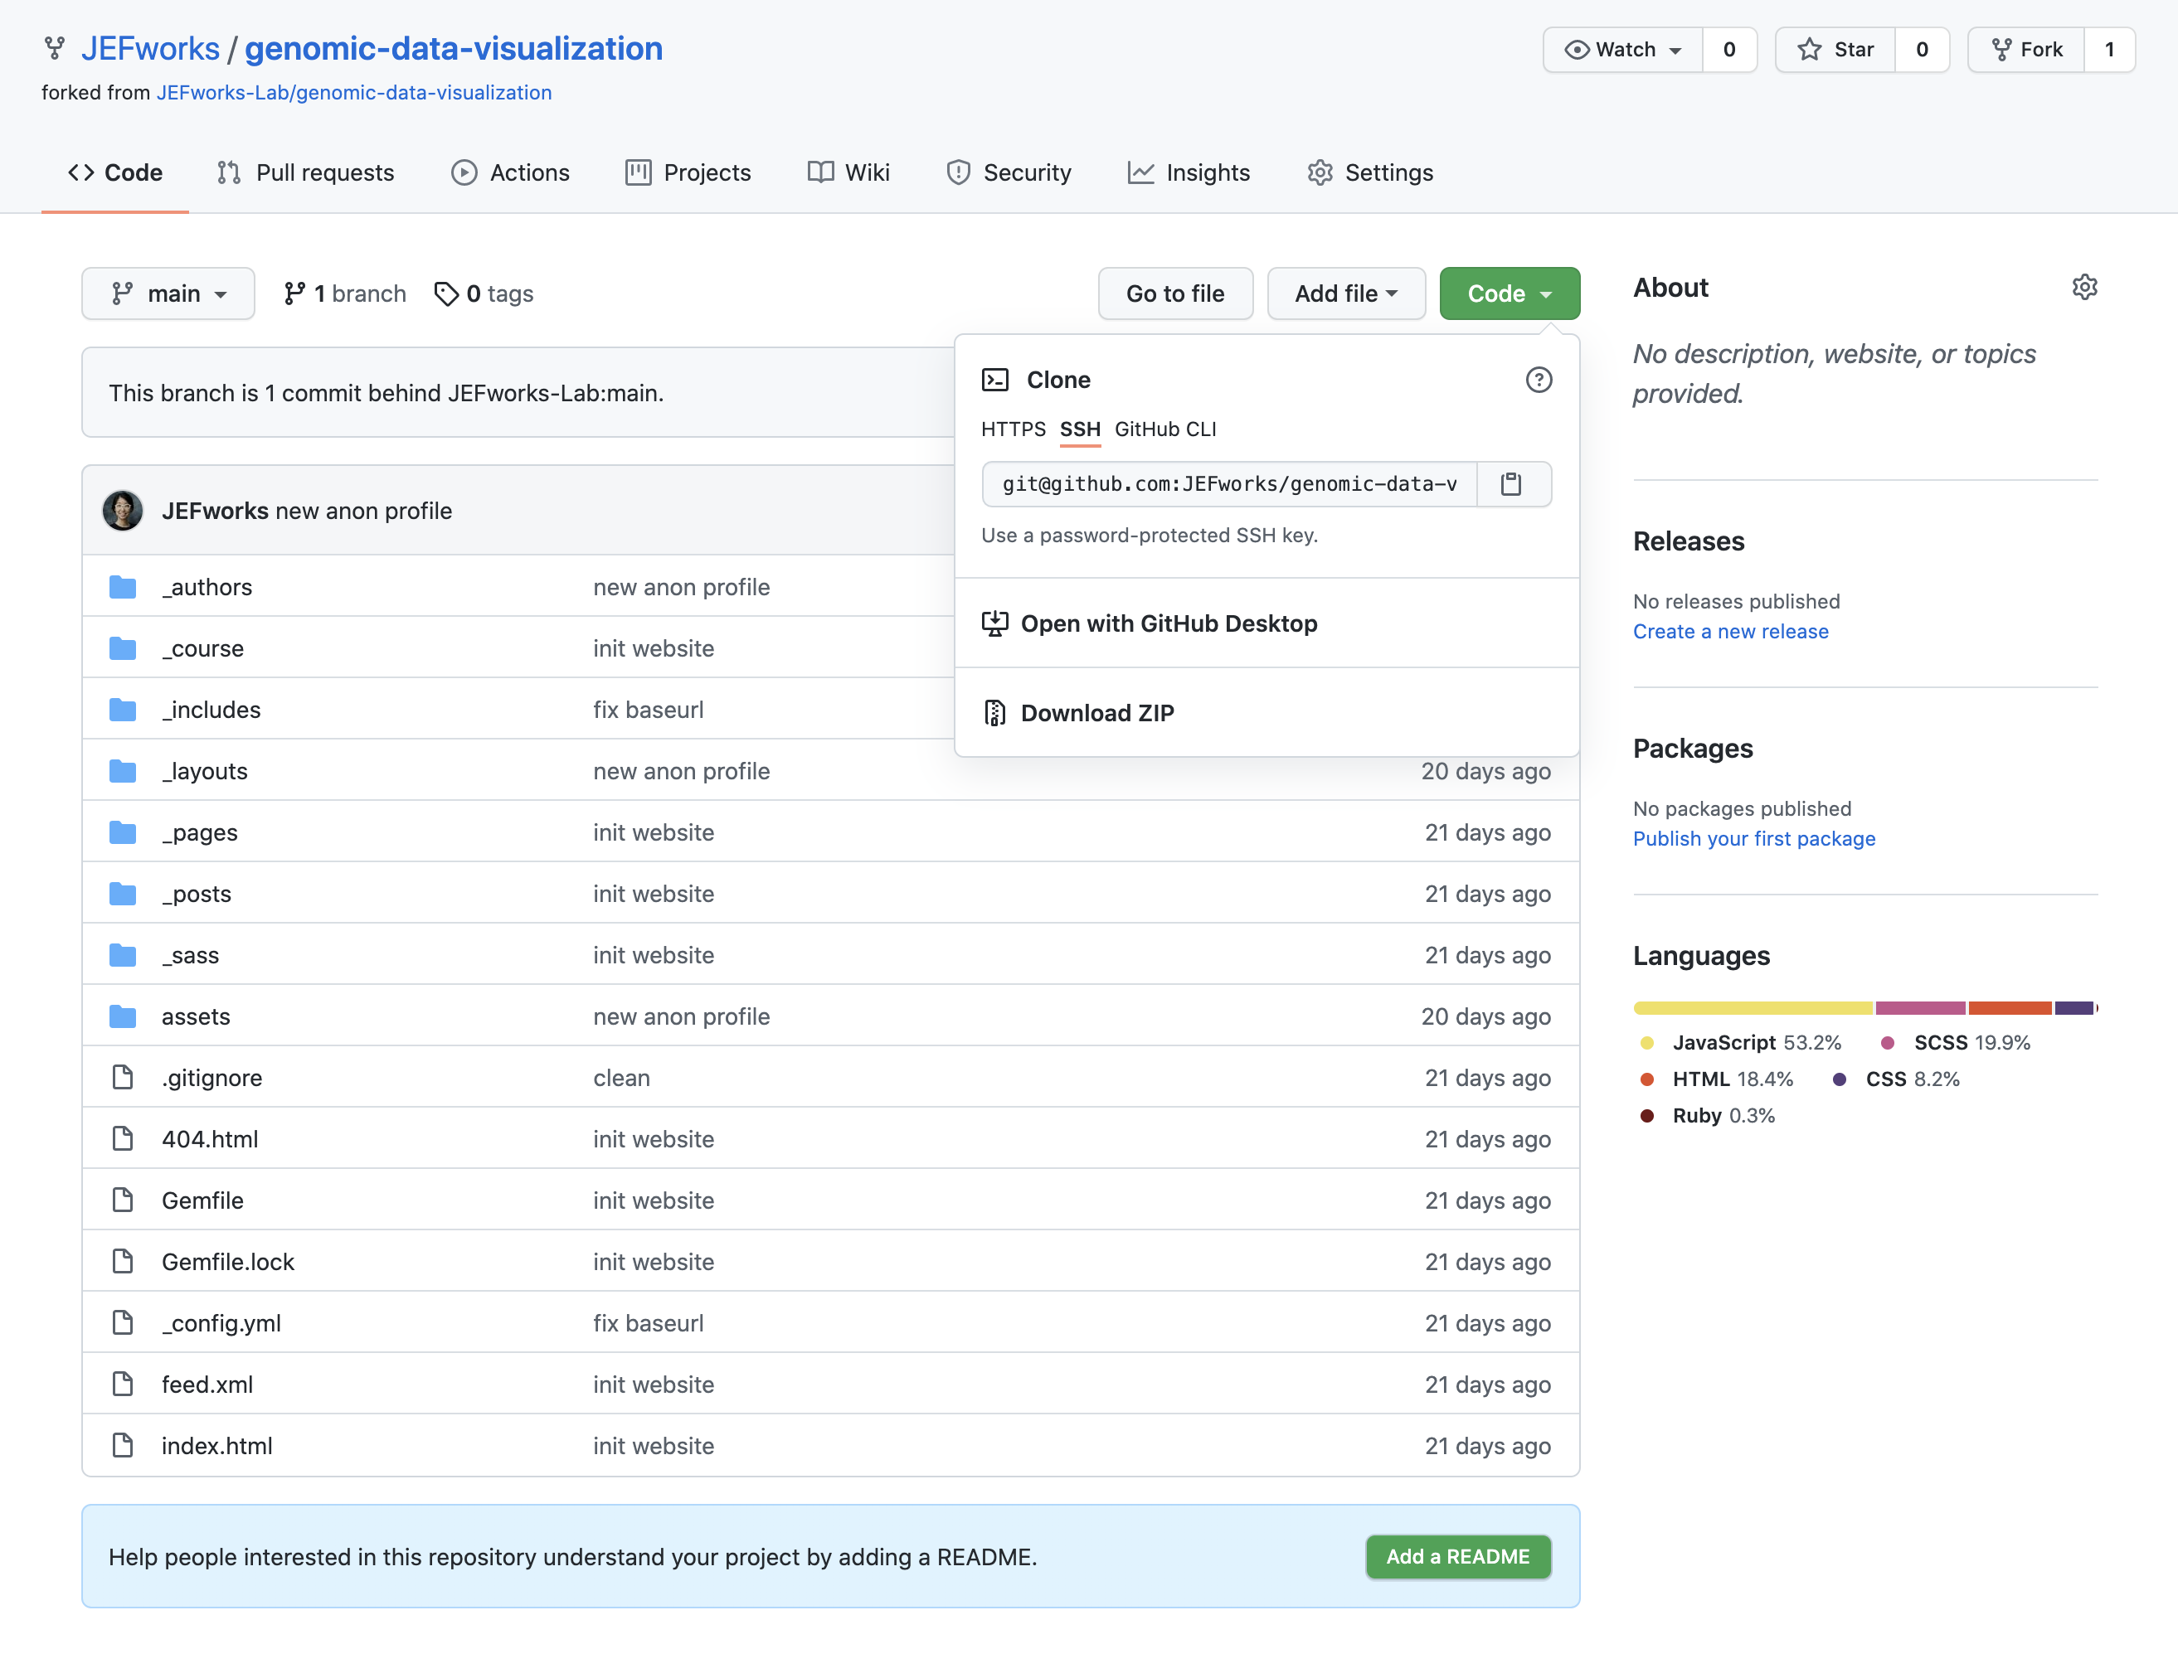
3. Clone the repo to your computer

Slide 6
4. Add a profile picture under the /profiles/ as [jhed].jpg
On your computer, add a 600x600 pixel photo of yourself under the profiles/ folder as [jhed].jpg
You can use a real photo of yourself, an avatar, or any fun (appropriate) picture.

Slide 7
5. Create a profile for yourself under the _authors/ folder as [jhed].md
under the _authors/ folder, copy the samplestudent.md markdown file to be [jhed].md
edit the name to your first name and last initial
change the avatar URL to the image you added under the /profiles/ folder

Slide 8
6. Commit and push your local changes to your Github.
Please double check that your changes are indeed on Github

Slide 9
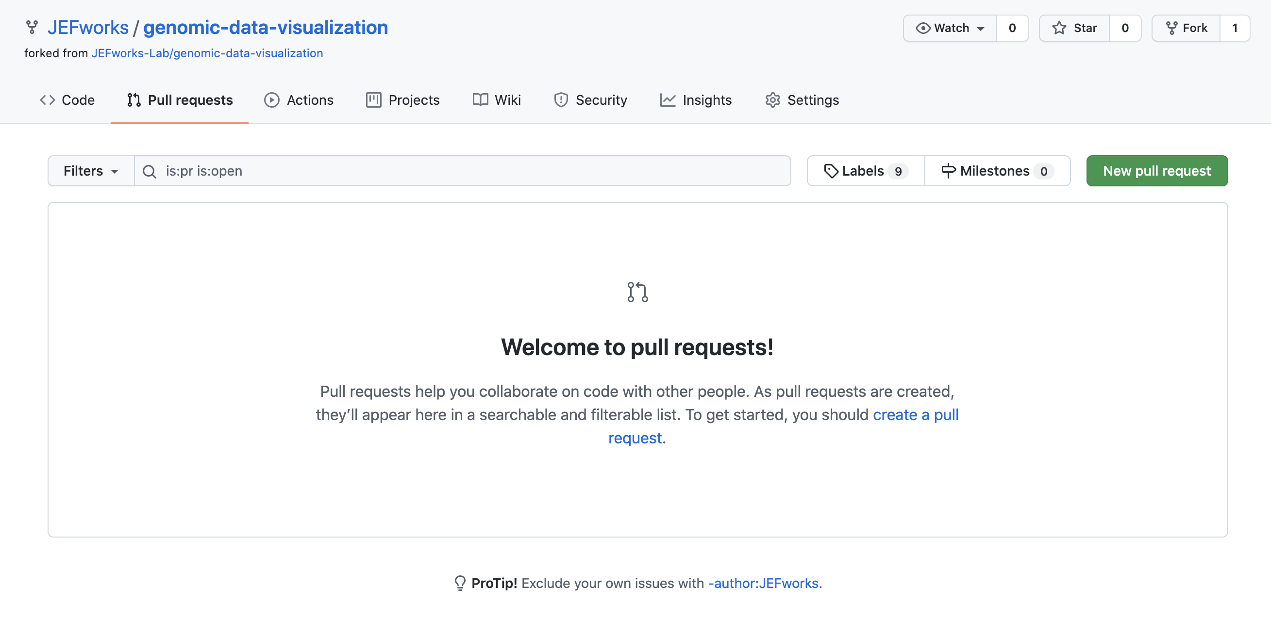
7. Make a pull request to submit this assignment and merge your changes back to the class repo.

Slide 10
Checking your HW Submission

Slide 11
To check that your homework Submission looks good, follow the following steps
0. Activate Github Pages on your personal fork
1. Go to [yourusername].github.io/genomic-data-visualization-2023 to see that the changes you made are present
2. Now you can be confident that when you make a pull request to submit this assignment, the changes you want will be merged back to the class repo

Slide 12
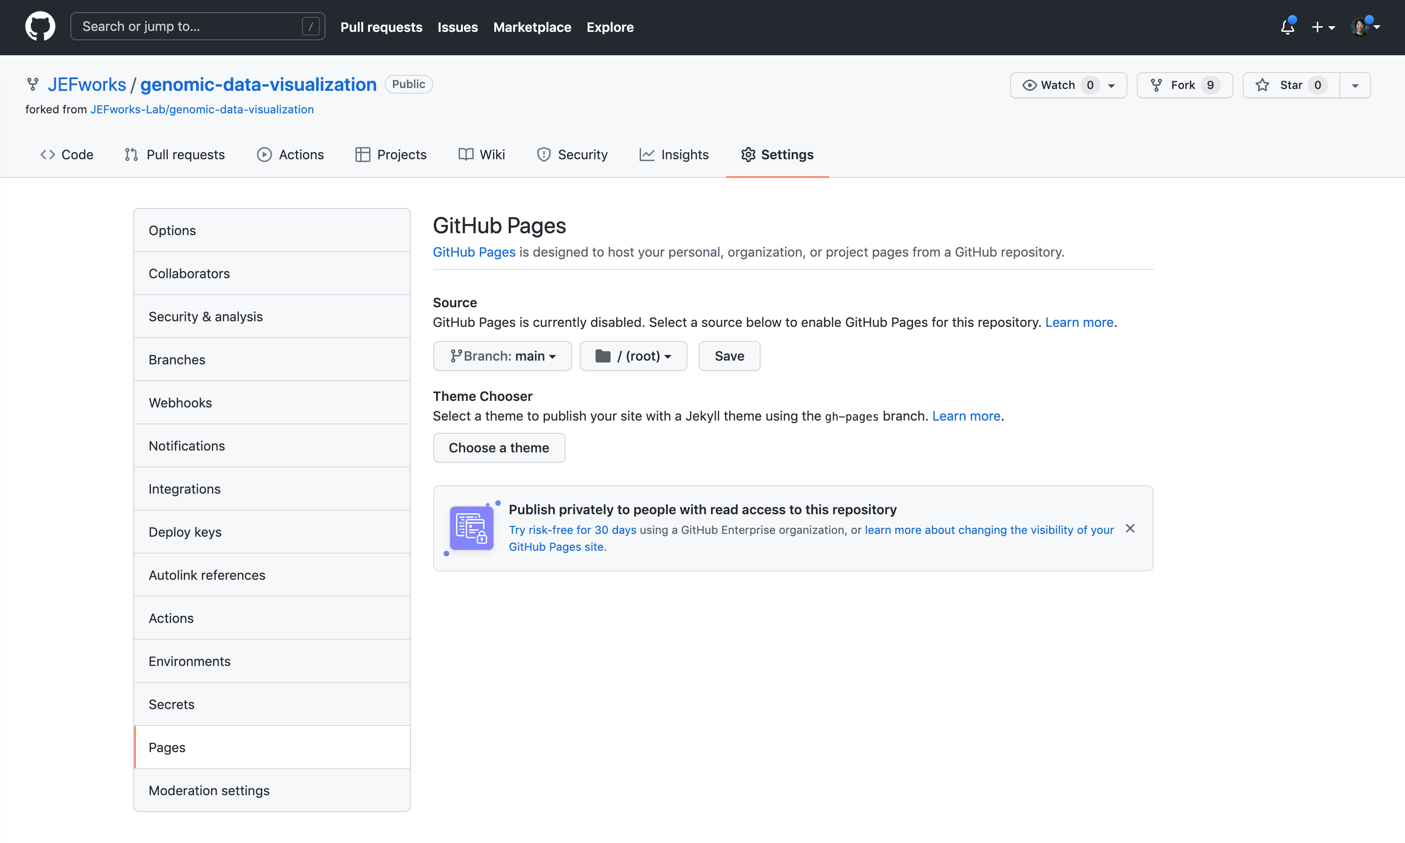
0. Activate Github Pages on your personal fork
Go to Settings -> Pages
Then change the Source to main/

Slide 13
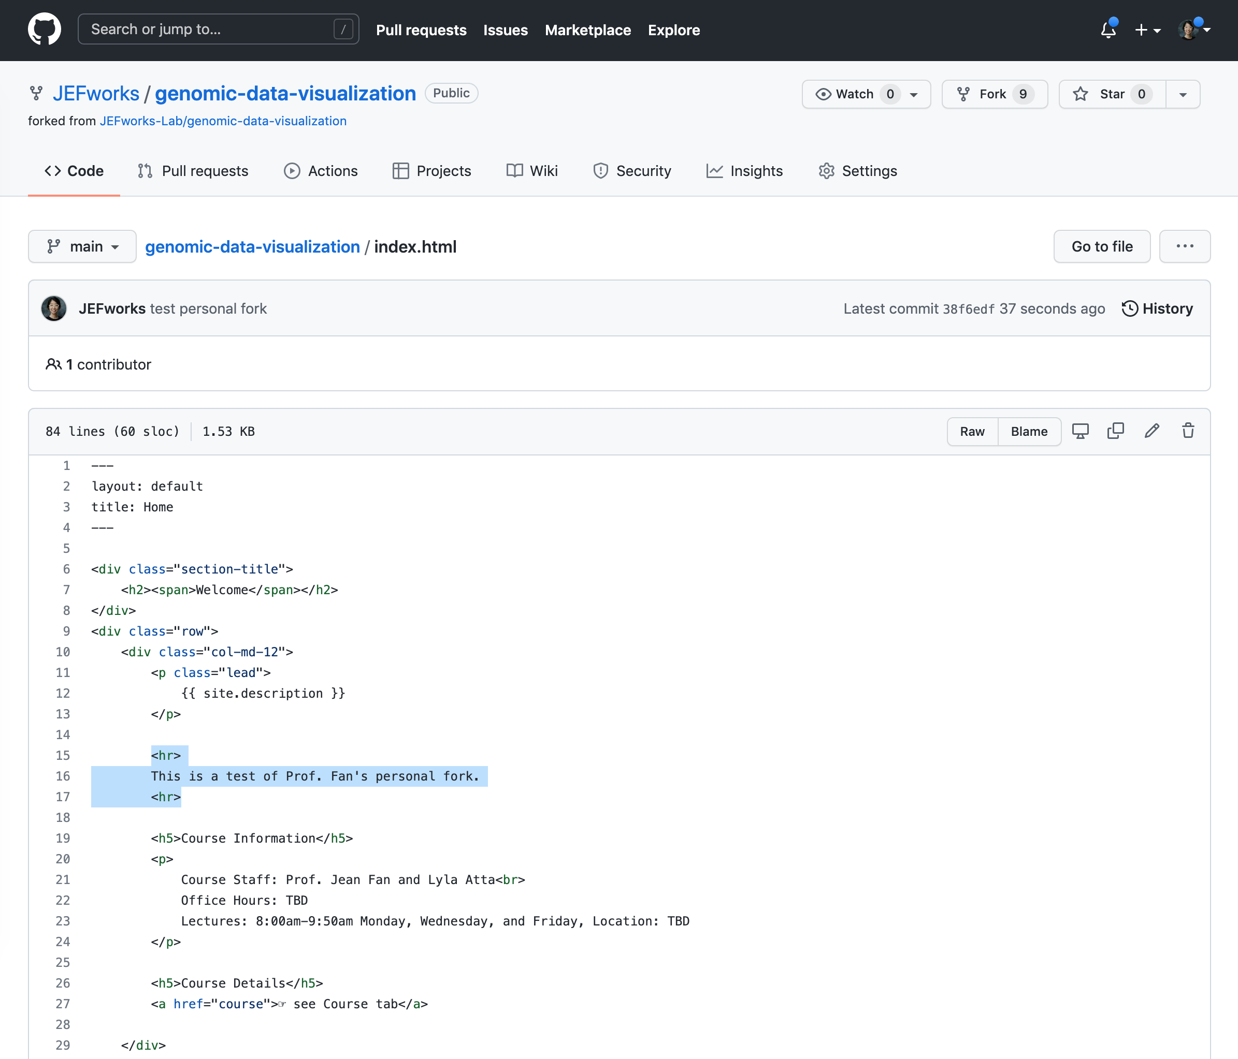
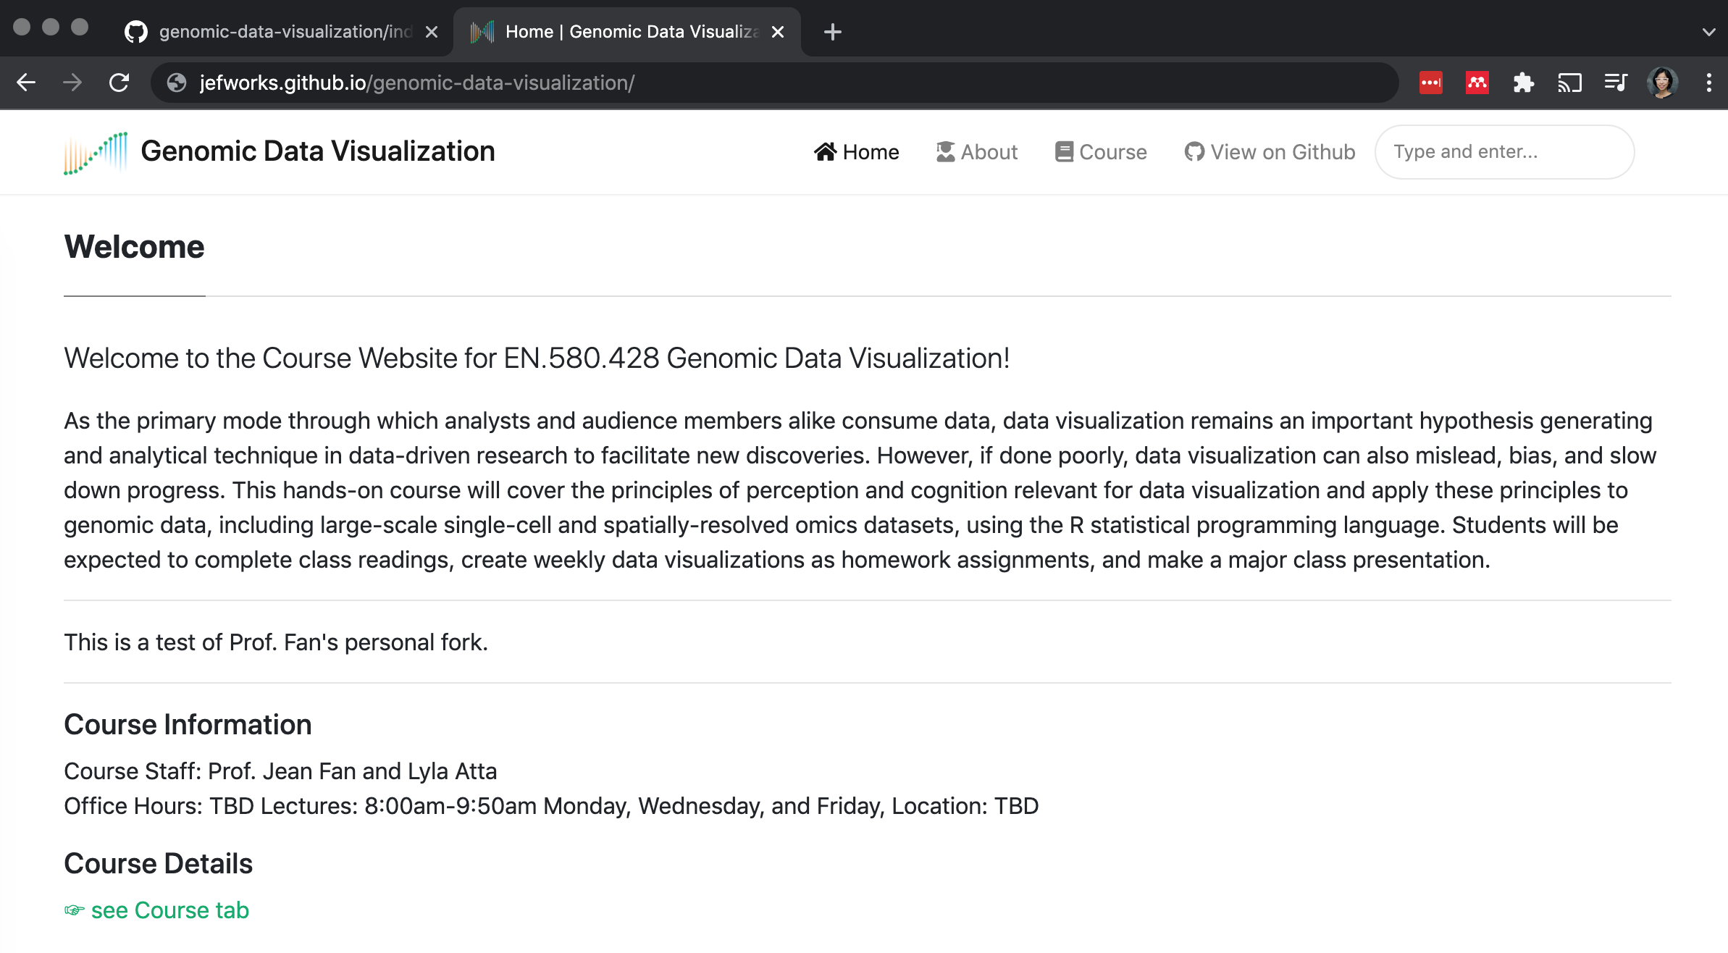
Go to [yourusername].github.io/genomic-data-visualization-2023

