Slide 1
Spatial Proteomics
Prof. Jean Fan

Slide 2
HW6 due Thursday: Create a multi-panel data visualization to interpret a cell cluster in the Visium data (bit.ly/GDV23_visiumBC)
Perform a full analysis (quality control, dimensionality reduction, kmeans clustering, differential expression analysis) on your data. Pick ONE cluster and try to figure out what cell-type(s) it corresponds to. Create a data visualization and write a description to convince me that your interpretation is correct.
You are welcome to reuse code from HW5 or even use code from other students. However, you must provide attribution (credit) if you do so.
Your description should reference papers and content that allowed you to interpret your cell cluster as a particular cell-type(s). You must provide attribution to external resources referenced. Links are fine; formatted references are not required. (You do not need to describe the data visualization as you have been doing)
You must include the entire code you used to generate the figure so that it can be reproduced.

Slide 3
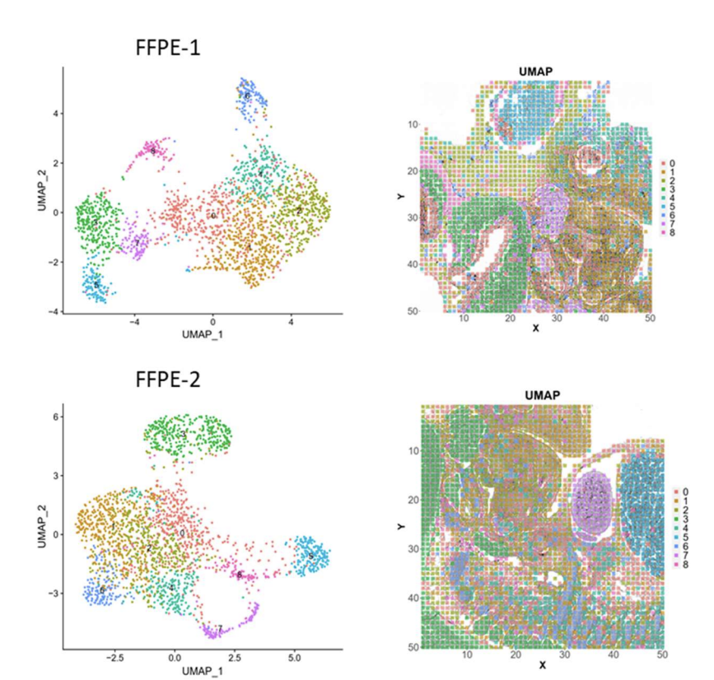
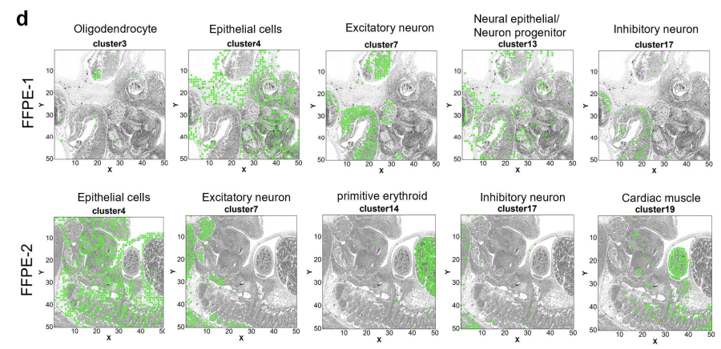
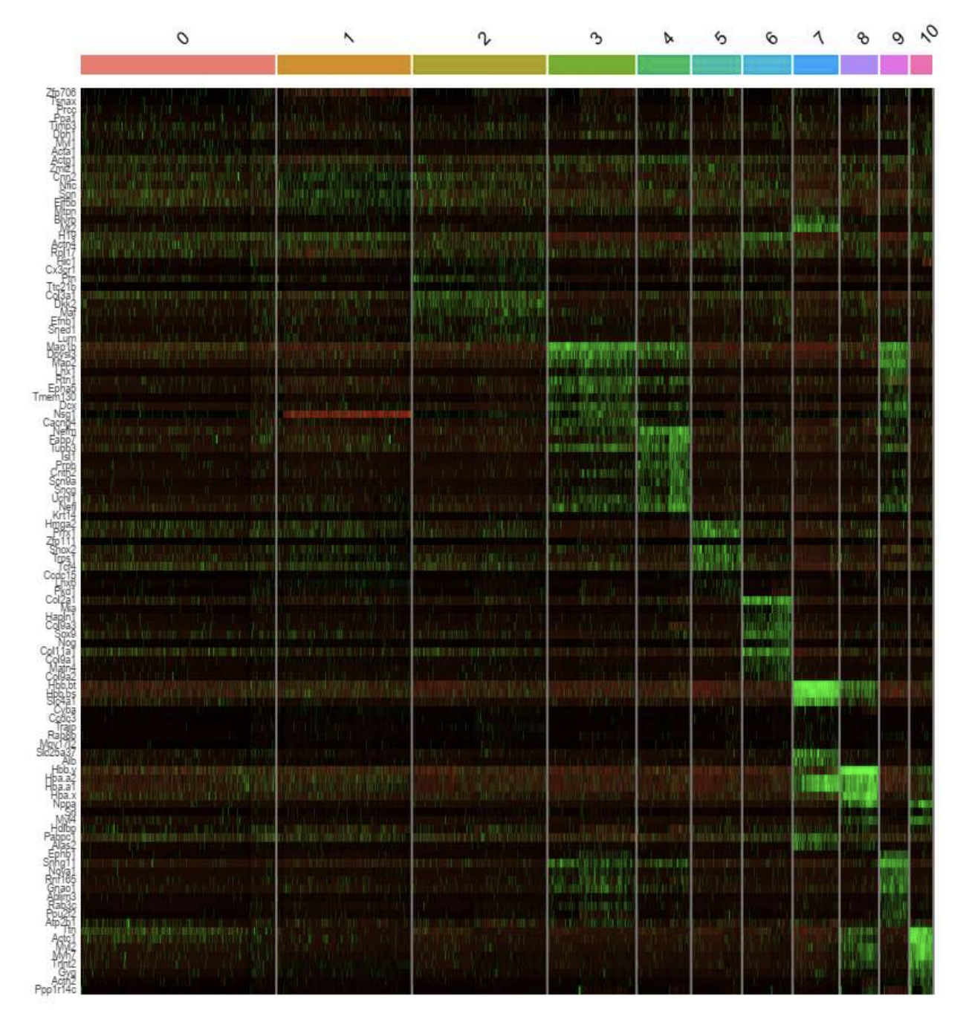
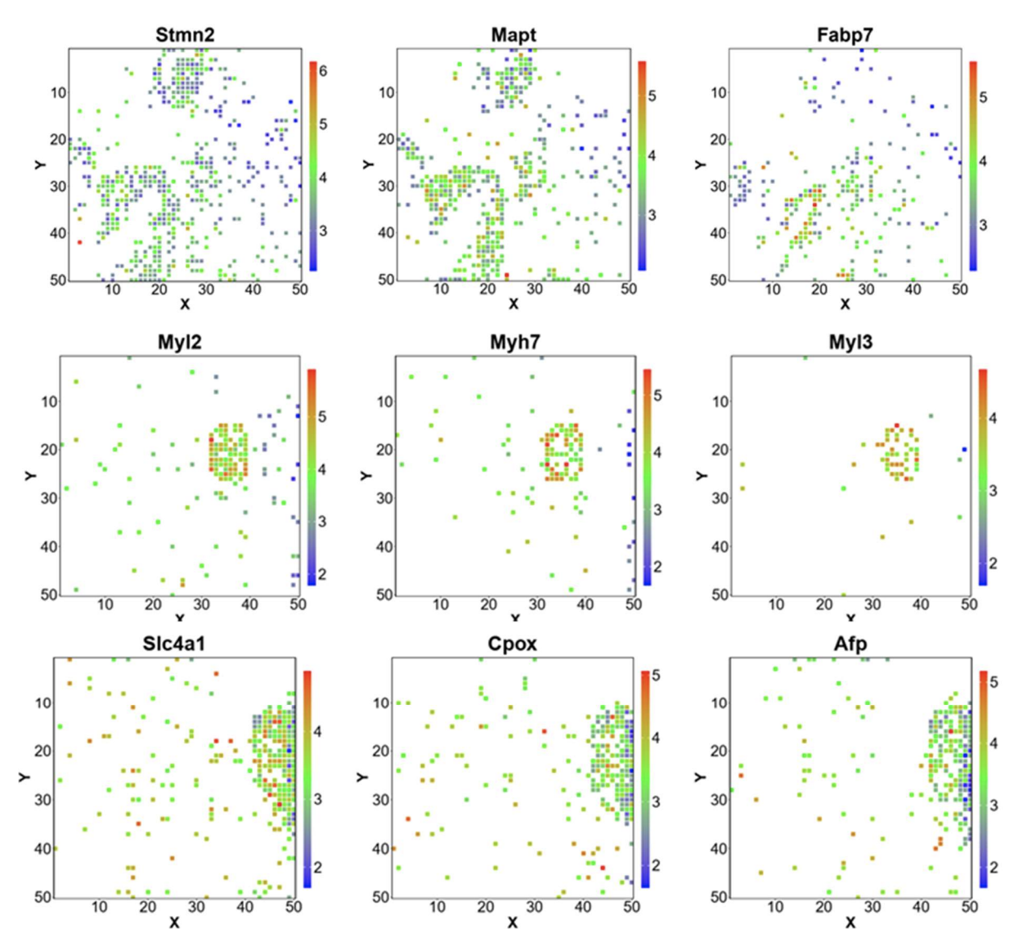
Homework tips: Your goal is to convince me that your cell-type interpretation is justified (actually being correct is not important here; your process and use of data visualization is key)
https://www.biorxiv.org/content/10.1101/2020.10.13.338475v2.full.pdf

Slide 4
Review of spatially resolved transcriptomics by spot-based-capture and next-gen sequencing
Each of the Capture Areas has 5,000 uniquely spatially barcoded spots
Each spot contains on the order of millions of oligos

Slide 5
Review of spatially resolved transcriptomics by spot-based-capture and next-gen sequencing
spatial
barcode
gene
UMI
ATCGGATCGTATAAATGCGTAGCTAGTC----AATG----AGTT
ATCGGATCGTATAAATGCGTAGCTAGTC----TTTG----AGTT
ATCGGATCGTATAAATGCGTAGCTAGTC----TTTG----AGTT
TTGAGTATATGATGAAGATGAAAGGAT----AGGT----AGTT
TTGAGTATATGATGAAGATGAAAGGAT----ATTG----GTAA
TTGAGTATATGATGAAGATGAAAGGAT----GATA----GTAA
…
…

Slide 6
Why protein?

Slide 7
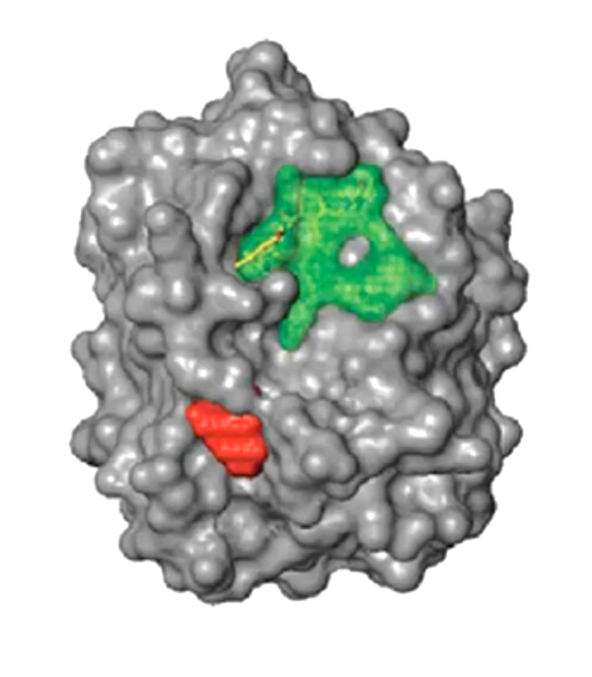
How can we detect proteins?
Protein
Epitope
(antigenic determinant)

Slide 8
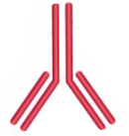
Protein epitopes can be identified with antibodies
(primary) Antibody

Slide 9
Ex. Immunofluorescence

Slide 10
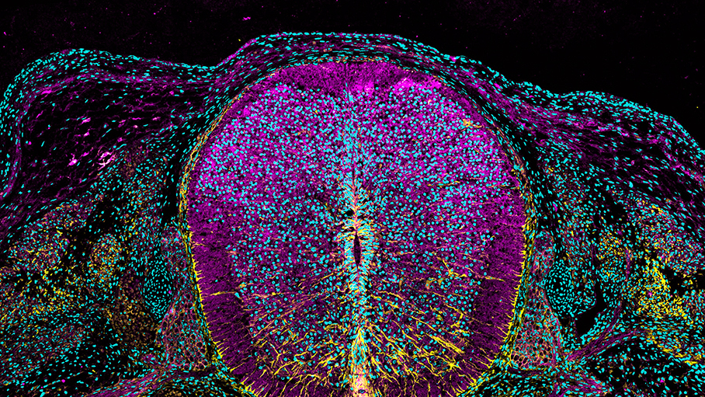
https://www.cell.com/pictureshow/immunofluorescence-ii
Vimentin (yellow)
N-cadherin (magenta)
Dapi (cyan)

Slide 11
What are antibodies? How are they made?

Slide 12
What are antibodies? How are they made?
Can stop here
but b-cells
are polyclonal
+ don’t live long
Source: https://blog.addgene.org/antibodies-101-monoclonal-antibodies

Slide 13
What are antibodies? How are they made?
1970s (Nobel Prize of 1984)
Source: https://blog.addgene.org/antibodies-101-monoclonal-antibodies

Slide 14
CODEX (CO-Detection by indEXing)
Dr. Gary Nolan at Stanford
Black, et al. Nat Protoc 2021

Slide 15
CODEX (CO-Detection by indEXing)
Dr. Gary Nolan at Stanford
Black, et al. Nat Protoc 2021

Slide 16
CODEX (CO-Detection by indEXing)
All antibodies hybridized at once
Akoya. Technical Note. Validation of CODEX Antibodies

Slide 17
CODEX (CO-Detection by indEXing)
~40 proteins
Akoya. Technical Note. Validation of CODEX Antibodies

Slide 18
Quick Question
We want to measure 18 proteins in a tissue
Using CODEX with 3 colors, we can measure 3 proteins in each imaging round
How many rounds of imaging do we need to image all 18 proteins?

Slide 19
Quick Question
Recall: MERFISH used a multiplexing scheme to increase the number of different genes that can be measured
Why do we not using multiplexing for proteins?
Black is 2^N
Purple is with modified hamming distance
Source: https://www.sciencedirect.com/science/article/abs/pii/S0076687916001324

Slide 20
What are some potential challenges for characterizing the proteome?
Proteins are big -> “crowding” (steric hindrance)
> 20k needed to measure the whole proteome
Very hard to get good antibodies
Good specificity

Slide 21
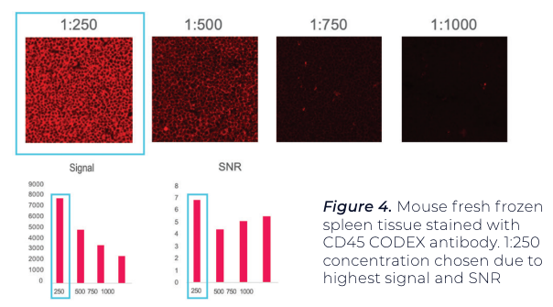
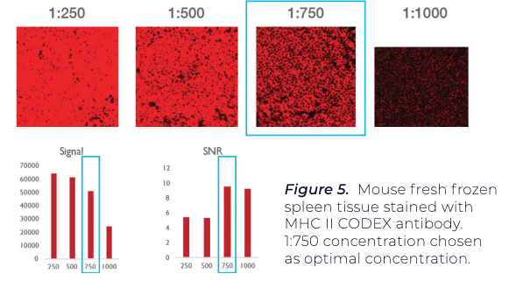
Antibody titration needed to minimize non-specific binding and improve signal to noise ratio
Using positive test tissue, maximize signal-to-noise ratio (SNR) and average signal.
A threshold is set for both signal and noise.
A binary map is used to confirm that pixels associated with signal and noise
Antibody A
Antibody B

Slide 22
Antibodies may interfere with each other (steric hindrance)
Even if it works well by itself, it may not give the same performance when used in combination with others. Therefore need to test:
Individually
In the presence of a few other antibodies (positive and negative counterstains)
In the presence of many other antibodies
1
2
3

Slide 23
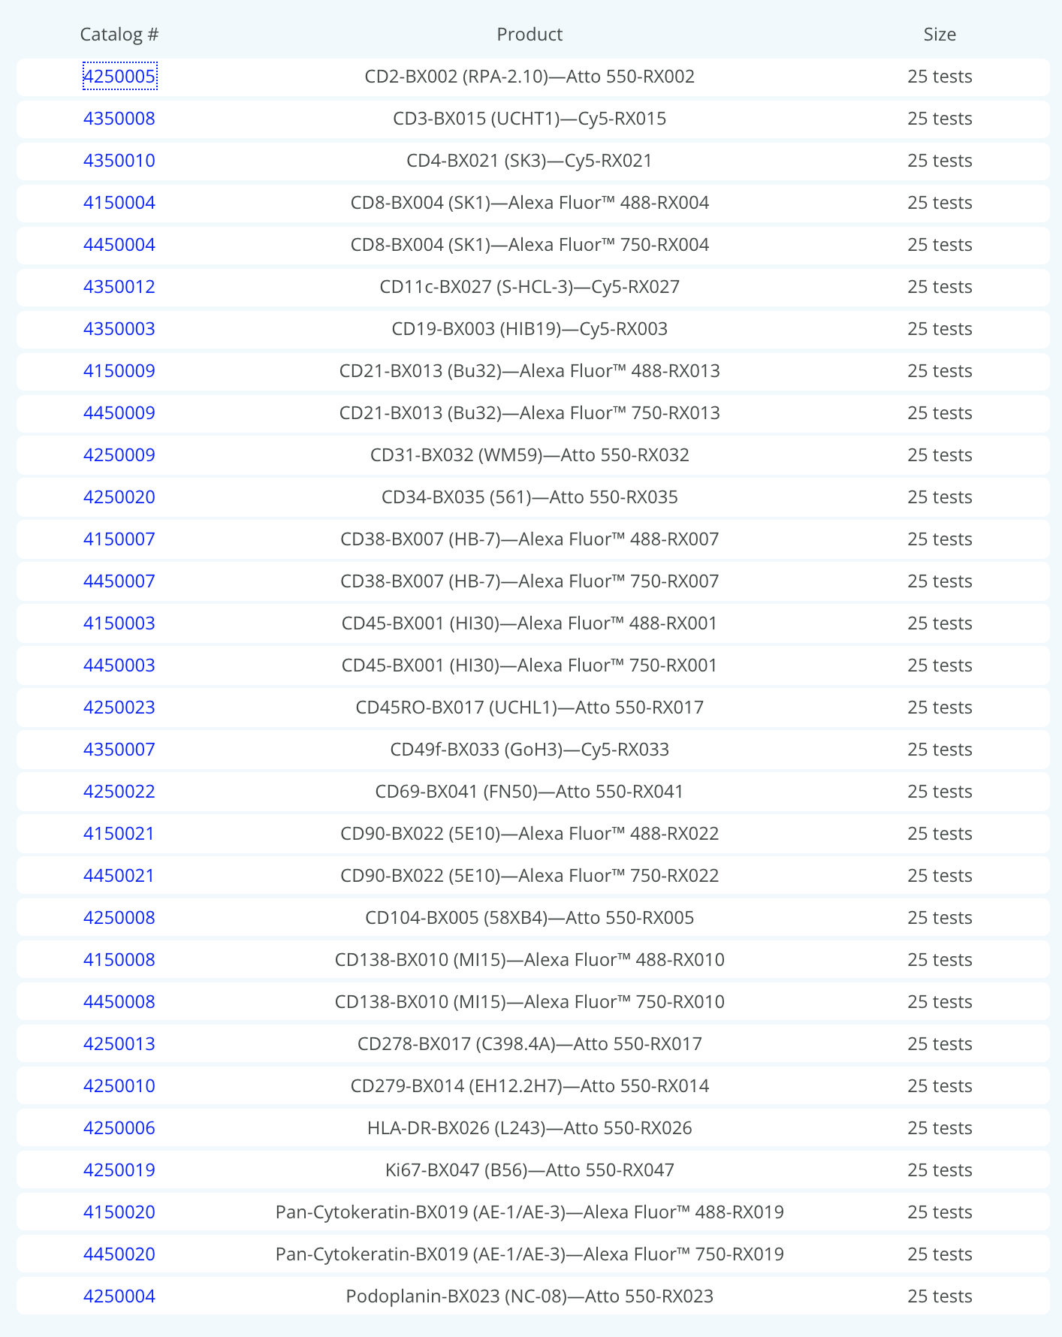
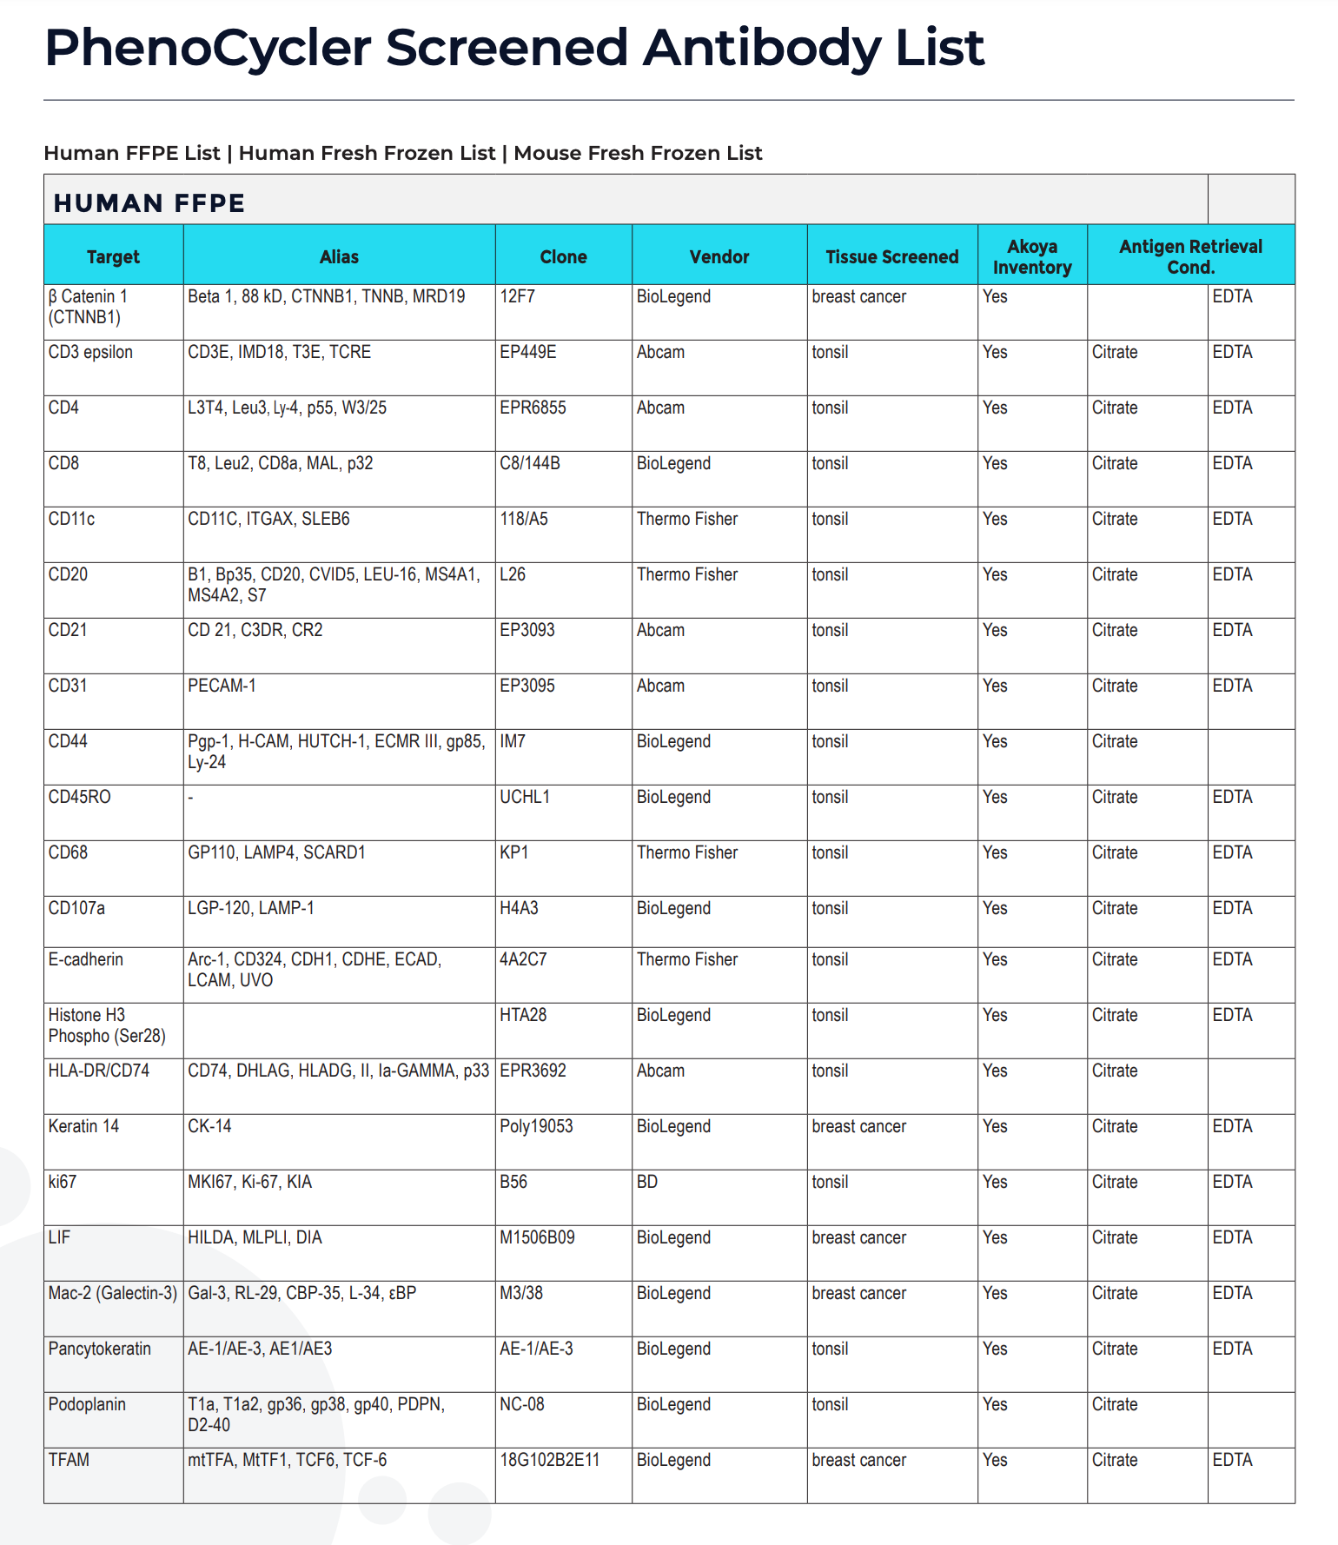
Antibodies for proteins of interest may not be available
~ 30 approved (work well together)
~ 300 screened (unclear if will work well together)
Notes:
80,000 to 400,000 proteins

Slide 24
Today’s hands on component: Look at spatial proteomics data: bit.ly/GDV_codex Extra Credit HW Assignment (like HW5 and HW6 but for this CODEX data)
Due 3/10 (Midnight) ie. before Final Class Presentations
See course website Assignment 13 for more details

