Slide 1
Interpreting cell clusters with differential expression analysis
Prof. Jean Fan

Slide 2
HW3 grades and feedback on Slack
Important to be precise in our language in describing our data visualizations (and our research/science in general)
Tip: .md is a markdown file. If you want to bullet, bold, italicize, add links, or do other fun things with your text, you can do so by following markdown formatting.
If you put your code in triple quotes, it will look nicer on the website
```
codeblock
````

Slide 3
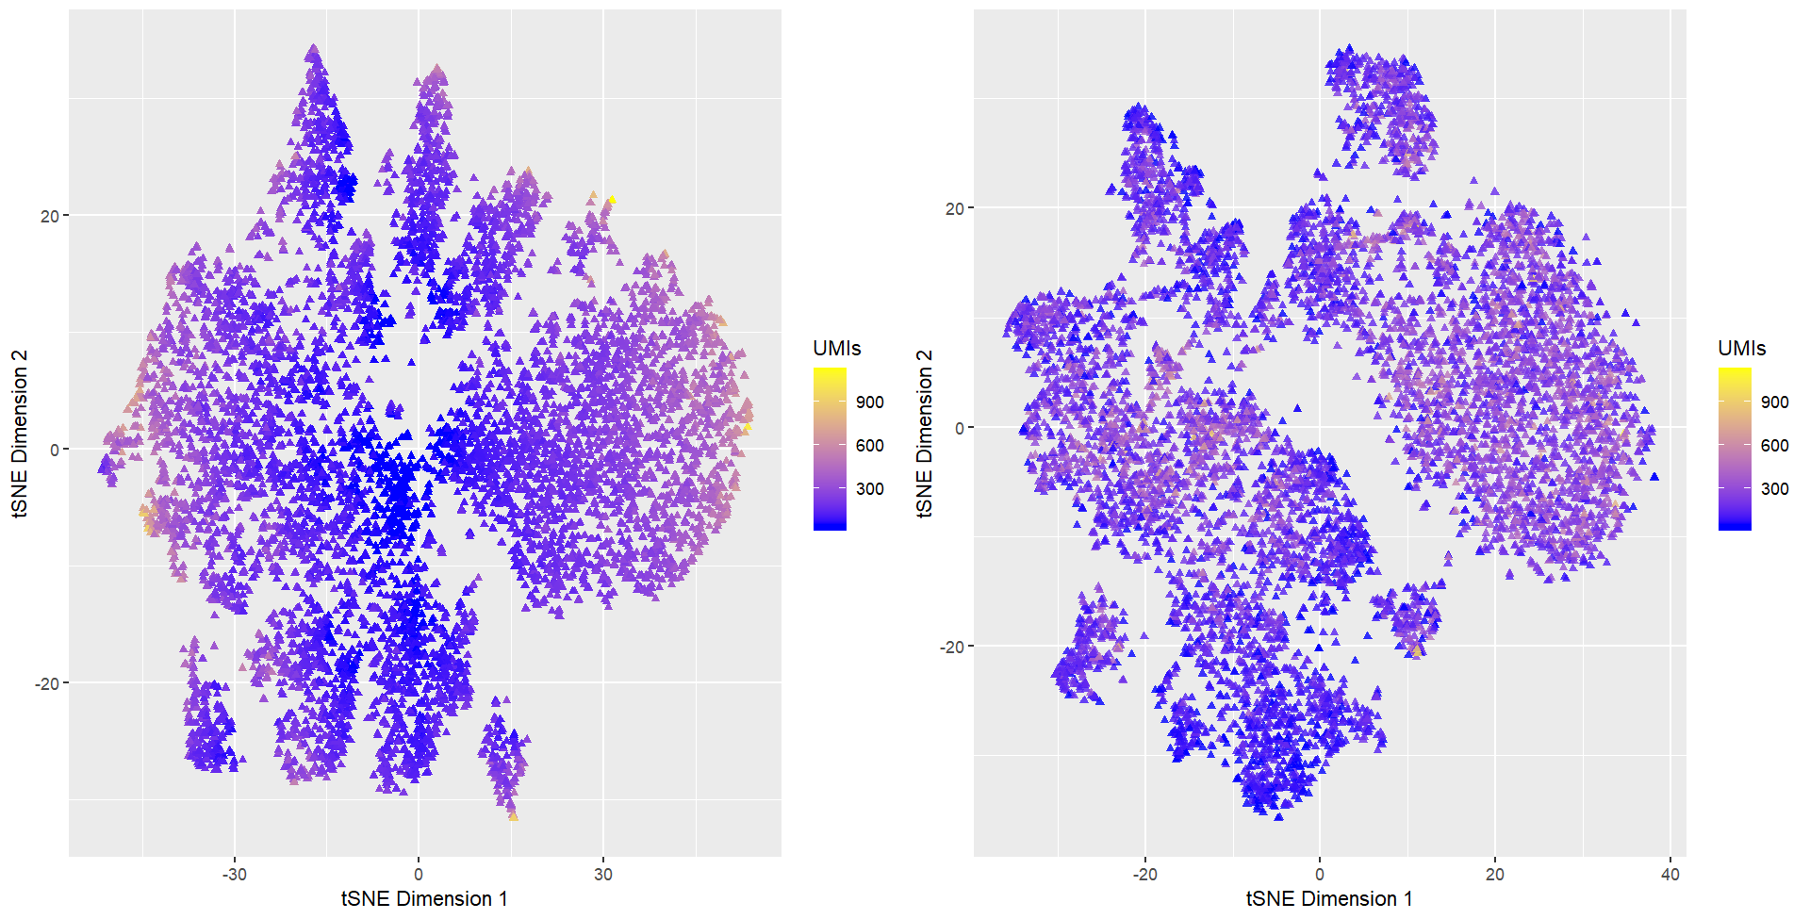
Should I normalize and/or transform the gene expression data prior to dimensionality reduction?

Slide 4
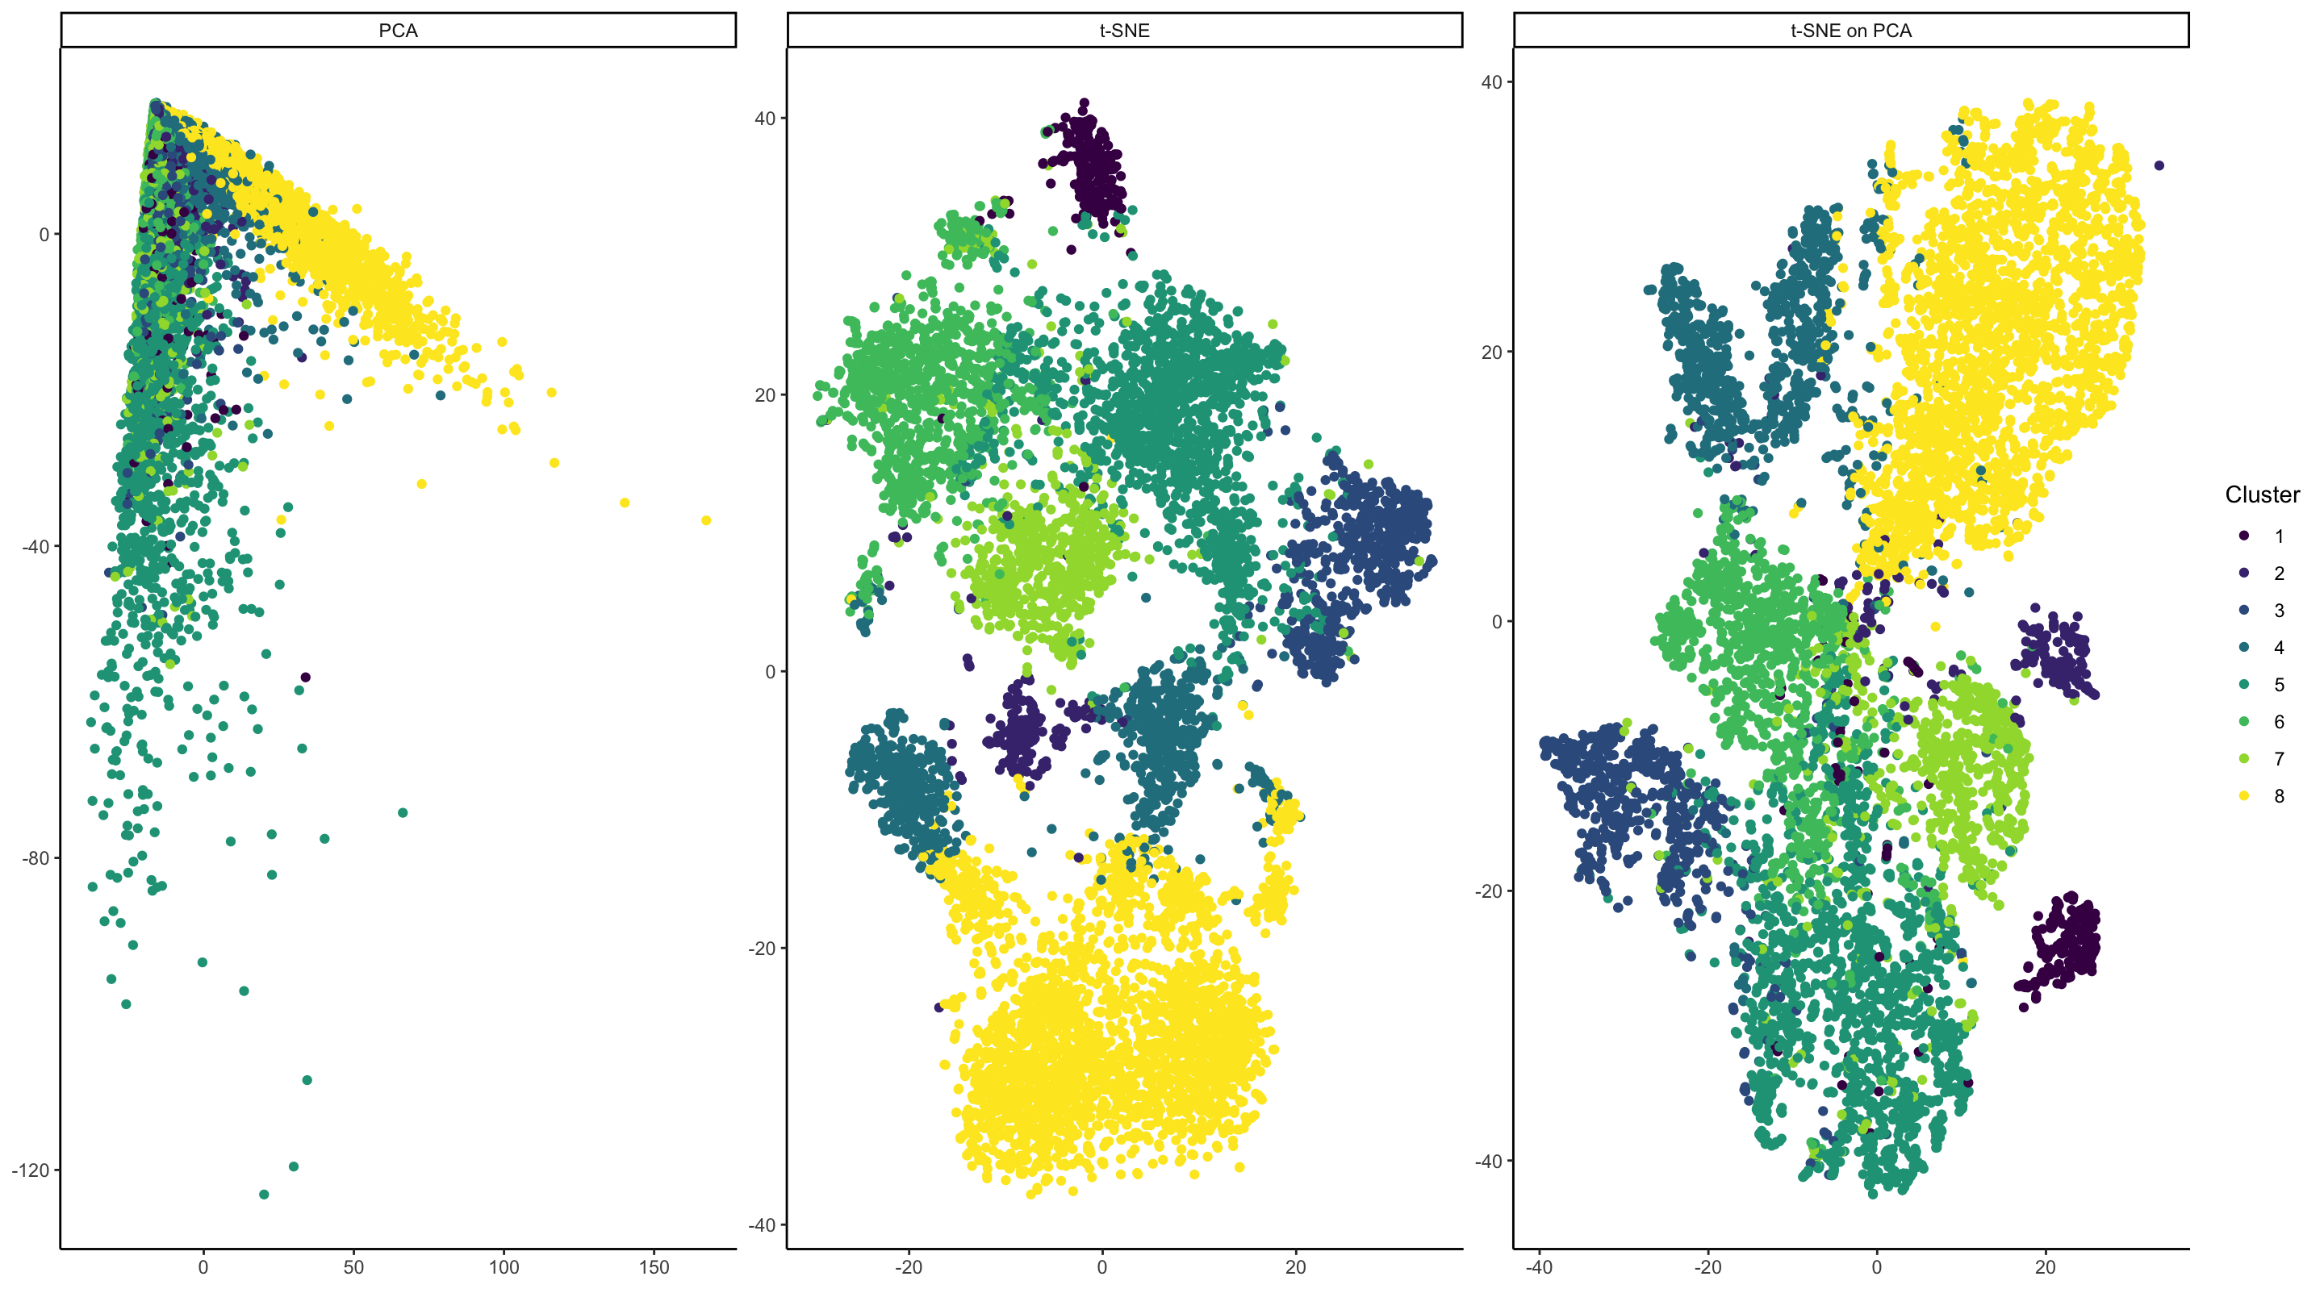
Should I perform non-linear dimensionality reduction on genes or PCs?

Slide 5
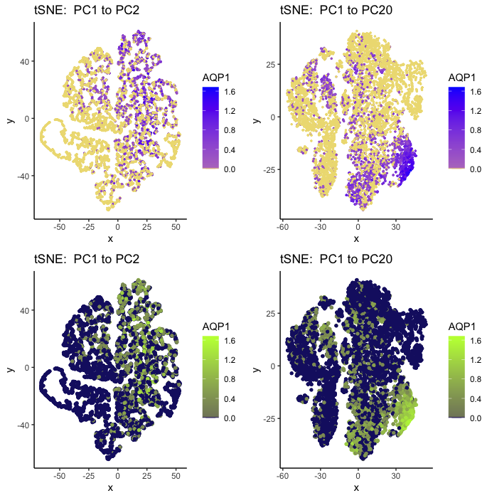
If I perform non-linear dimensionality reduction on PCs, how many PCs should I use?

Slide 6
Quiz 2

Slide 7
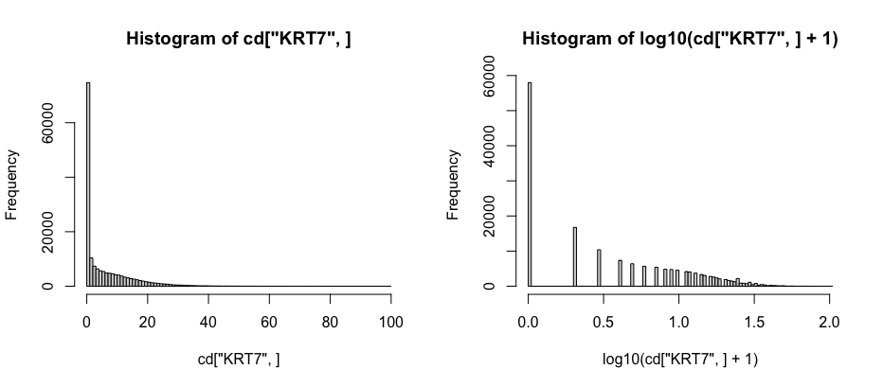
Review: Why transform data
Recall: we are using a log10 transform with a pseudocount of 1

Slide 8
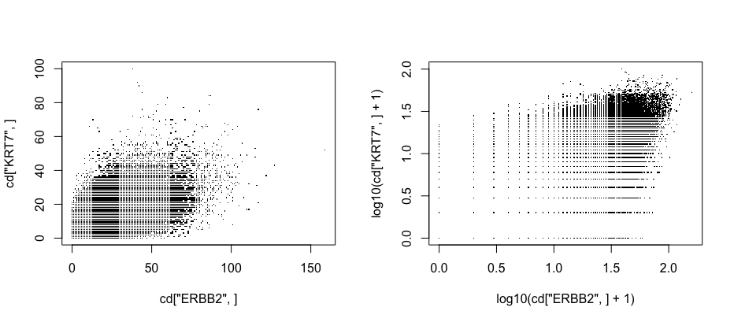
Review: Why transform data
Recall: we are using a log10 transform with a pseudocount of 1

Slide 9
Review: Why transform data
i
i
j
j

Slide 10
Definitions
Differentially expressed genes
Differentially upregulated genes

Slide 11
Motivation
Why identify differentially expressed genes?
Notes:
Differentially expressed genes
Differentially upregulated genes

Slide 12
Identifying differentially expressed genes

Slide 13
T-test

Slide 14
T-test assumptions and data visualization
that the data are quantitative and plausibly Gaussian
that the two samples come from distributions that may differ in their mean value, but not in the standard deviation

Slide 15
Mann Whitney U Test (Wilcoxon Rank Sum Test)

Slide 16
Other statistical tests
Many other tests that incorporate different normalizations, error modeling, Bayesian approaches, etc
Goal is to improve our statistical power in detecting true positives while minimizing false positives
Often becomes a trade-off with speed and computational complexity

Slide 17
Discussion
In a MERFISH experiment, I measure 100 genes. I identify 10 cell clusters. For one cell cluster, there is only 1 gene significantly upregulated. Do I believe this cell cluster represents a distinct cell-type? Why or why not?

