Slide 1
Visualizing differential gene expression and interpreting cell-types
Prof. Jean Fan

Slide 2
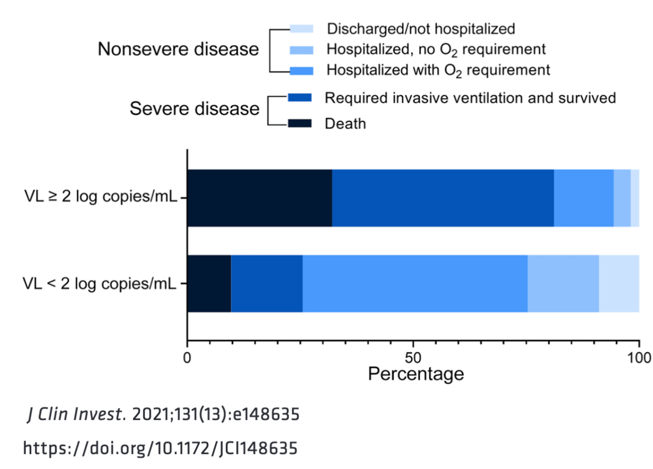
Quiz review: Part I

Slide 3
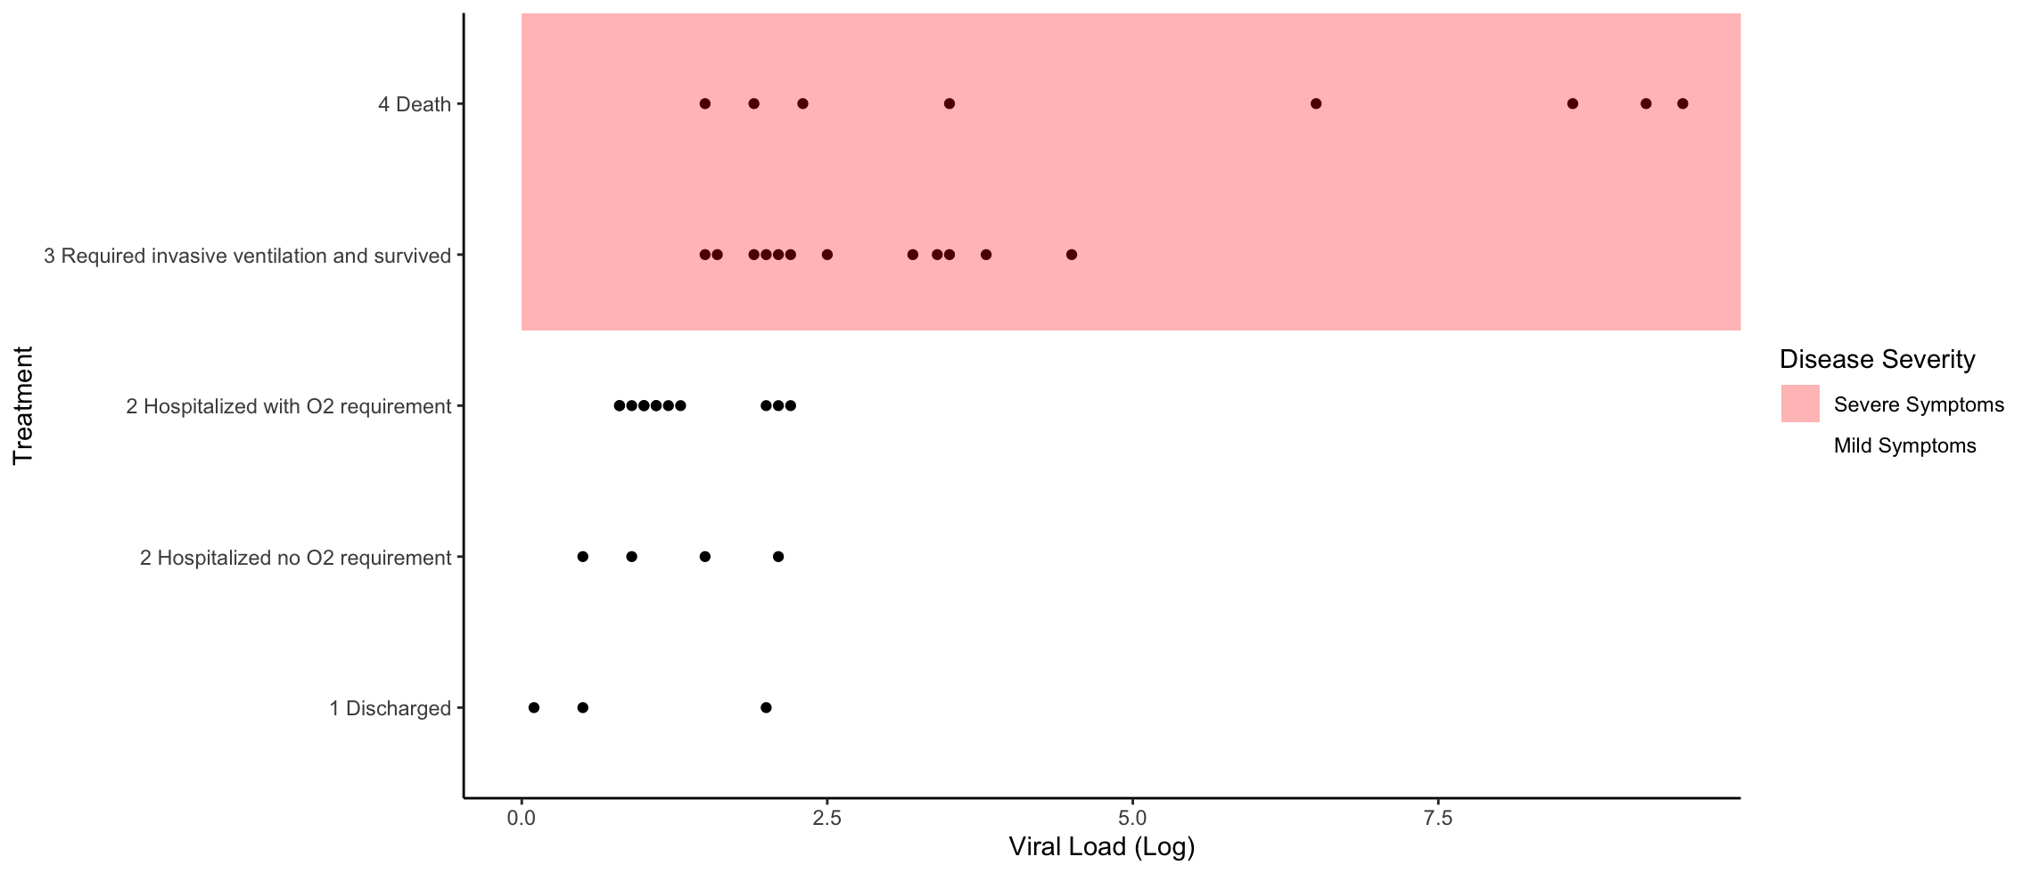
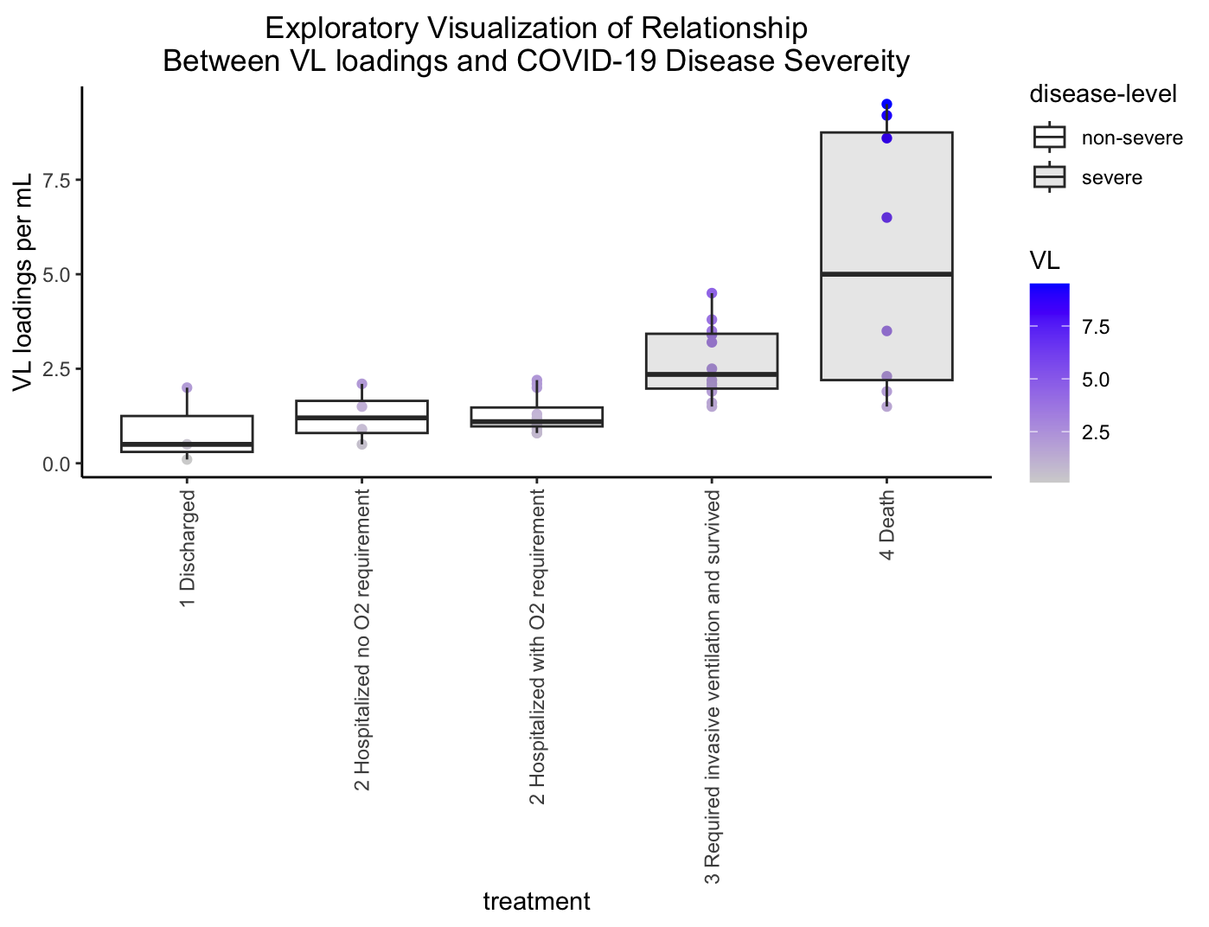
Diversity of data visualization redesigns

Slide 4
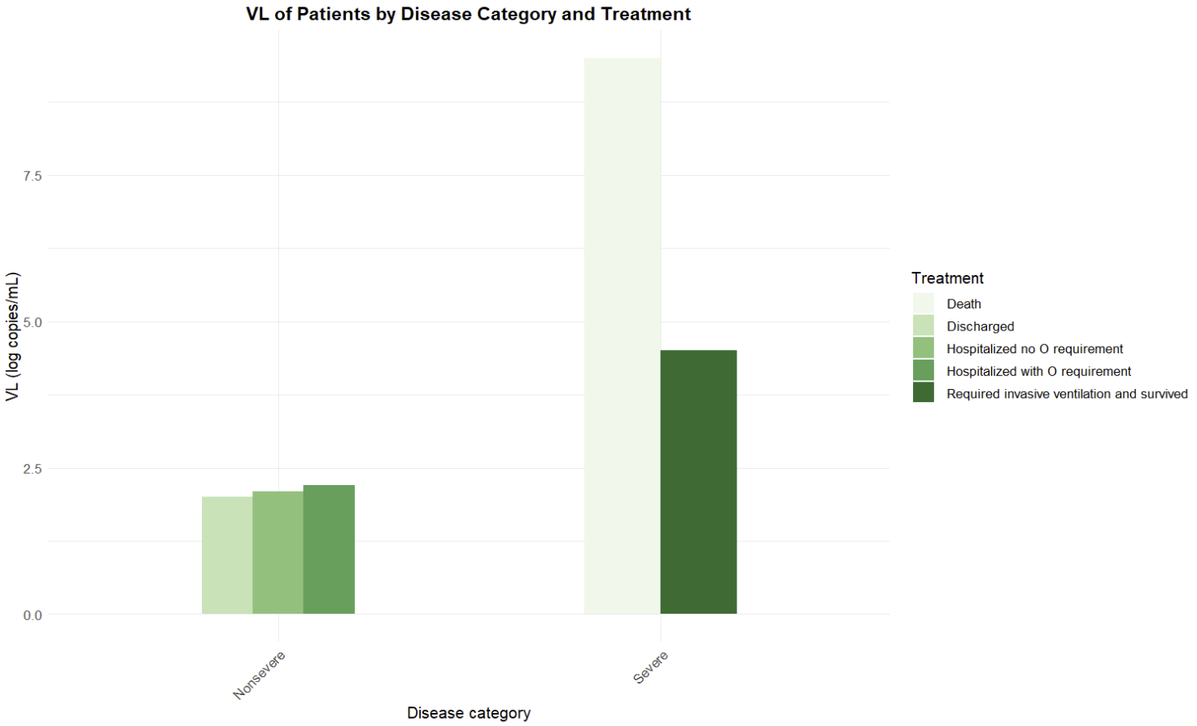
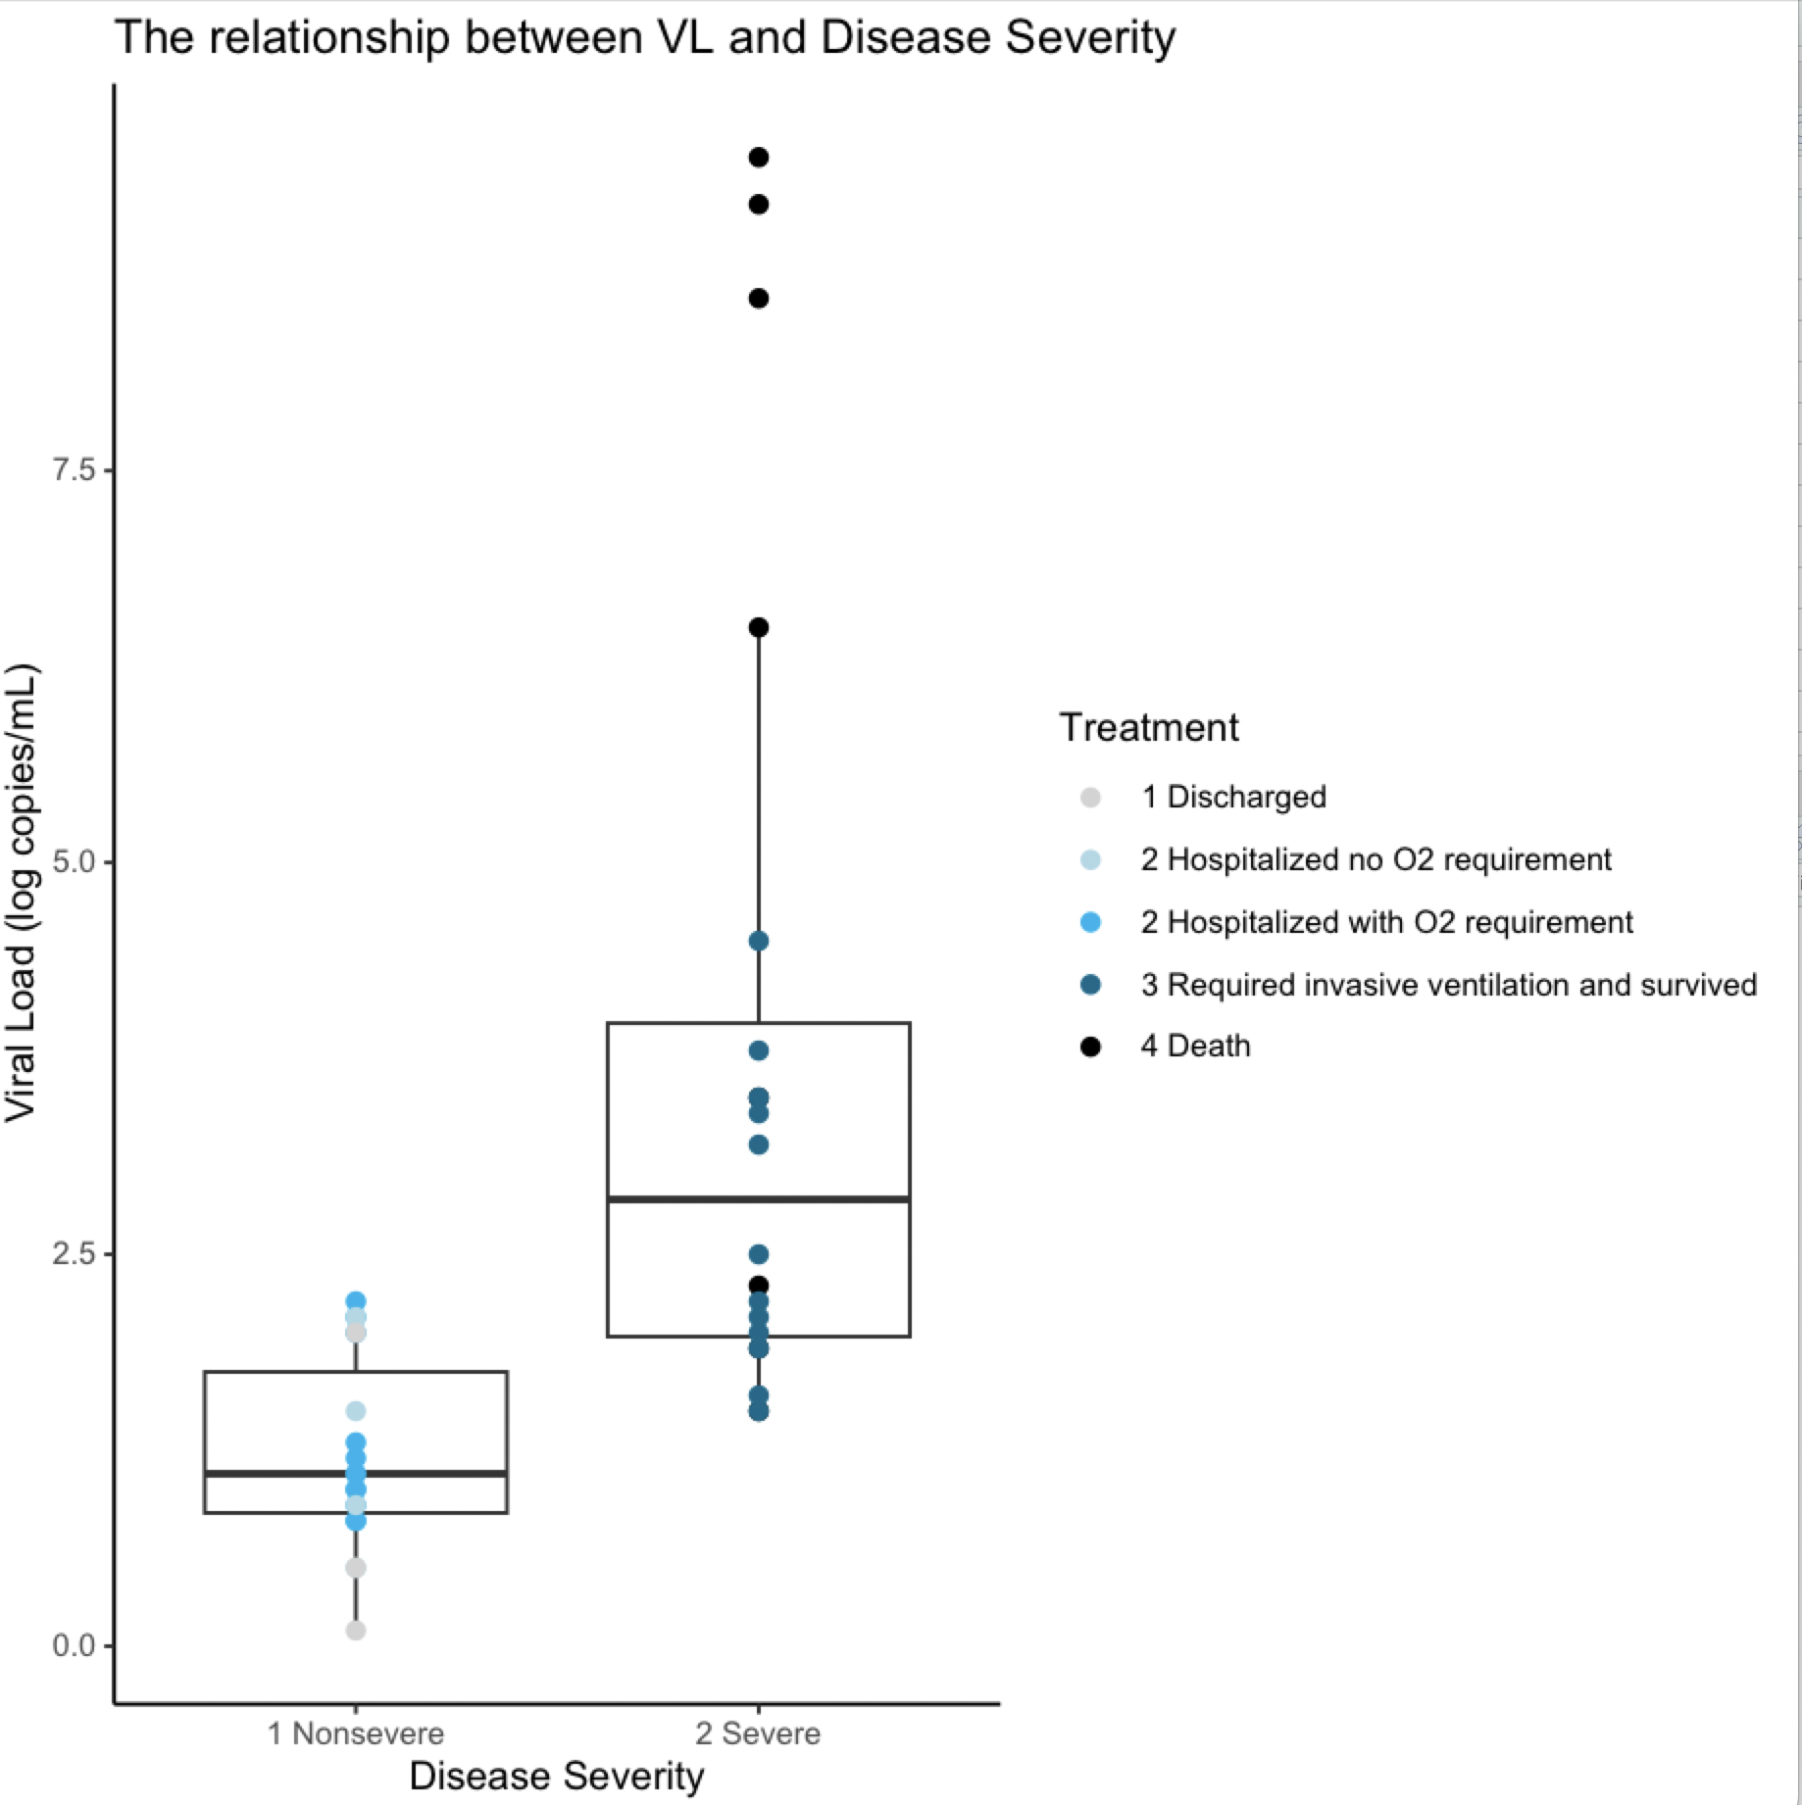
Diversity of data visualization redesigns

Slide 5
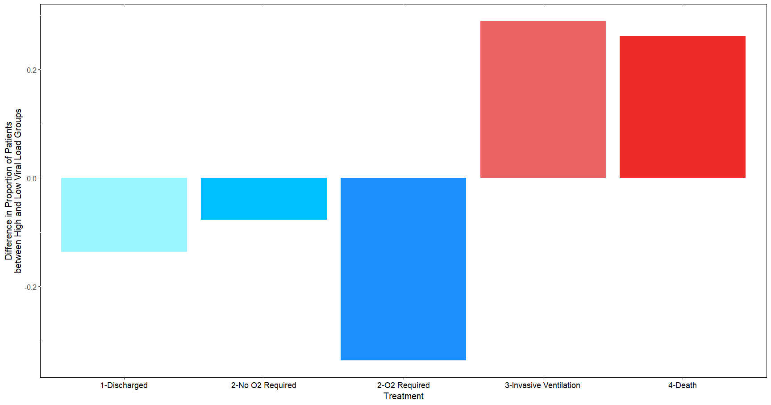
Diversity of data visualization redesigns

Slide 6
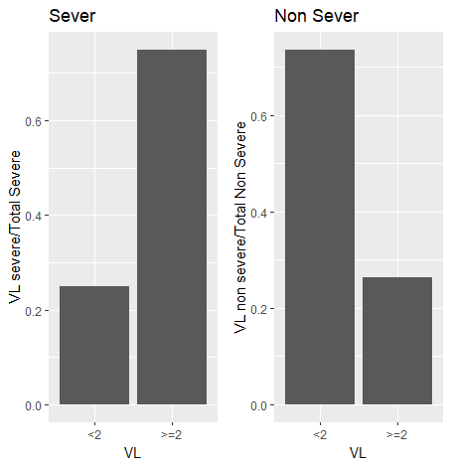
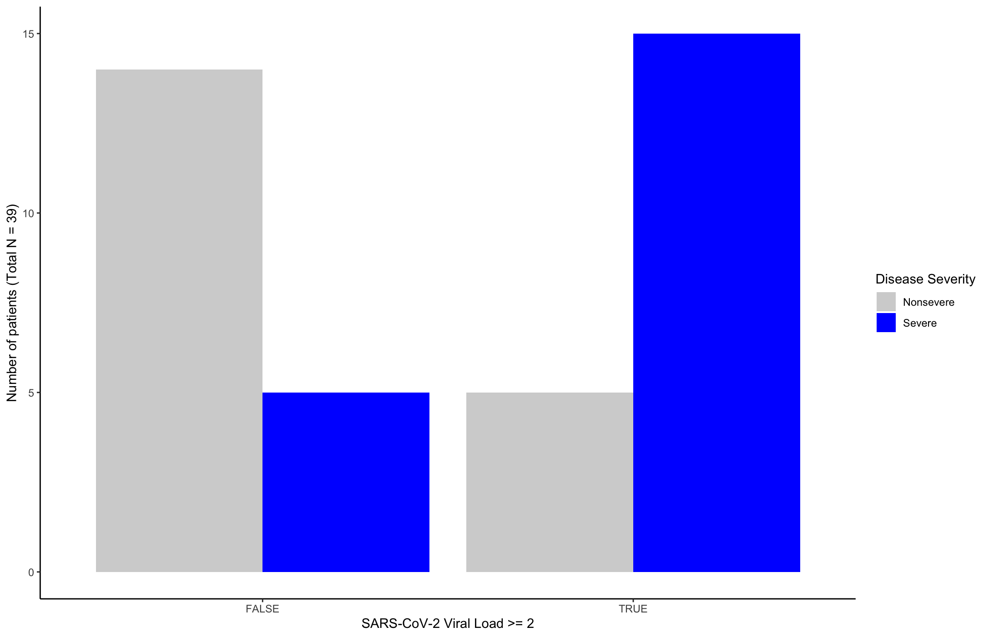
Diversity of data visualization redesigns

Slide 7
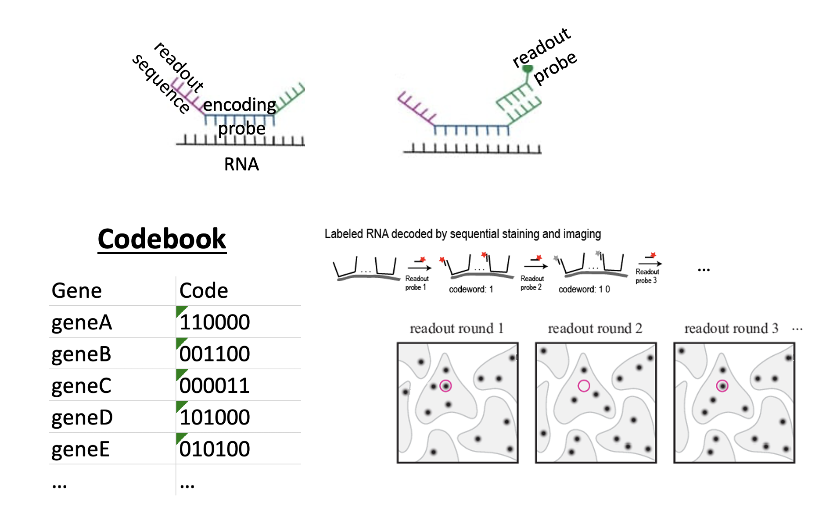
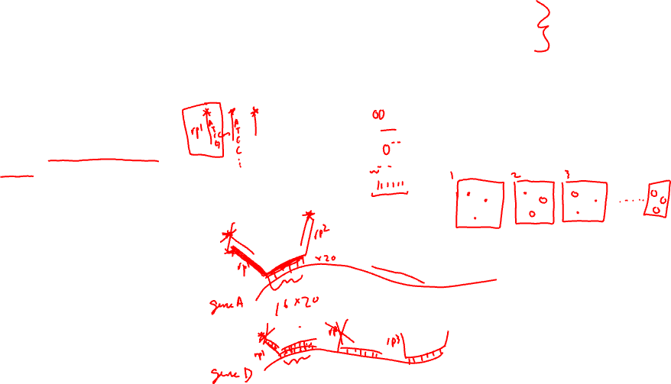
Quiz review: Part II
Q.2.1. Prof. Fan designs her probes such that each encoding probe (complementary to RNA of interest) is 16 base pairs, and each encoding probe has 1 round-specific read-out sequence (complementary to a read-out probe with a fluorescent tag).
At least 20 fluorescent tags are needed to create a spot that is bright enough to be imaged.
Assume encoding probes cannot overlap but can be placed perfectly side by side.
What is theoretically the shortest gene in terms of number of base pairs that Prof. Fan can target based on this design? (2 pts)

Slide 8
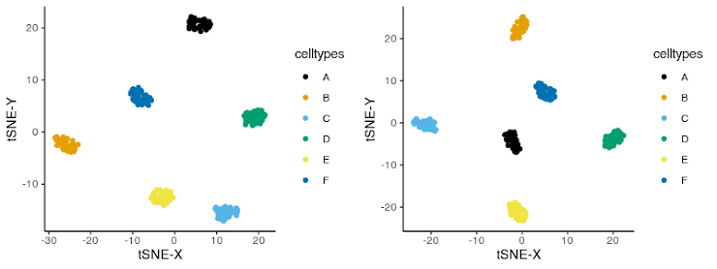
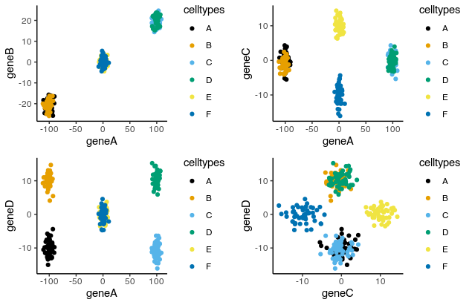
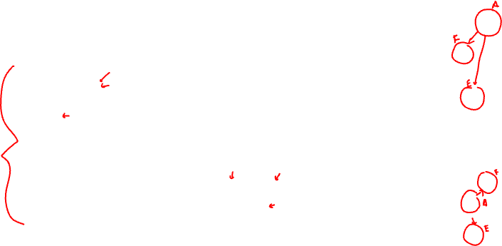
Quiz review: Part III

Slide 9
Additional notes
If you want to know more about your specific quiz -> slack or office hours
Look over quiz and try to redo it on your own for your own learning
  There will be at least 2 extra credit assignments that will be assigned in the coming weeks

Slide 10
Up til now
Read in spatial transcriptomics data
Visualize gene expression in space
Compare gene expression
Linear and nonlinear dimensionality reduction
Kmeans clustering to identify transcriptionally distinct groups of cells
Differential expression analysis to characterize significantly upregulated and downregulated genes in each group of cells (versus all other cells)
Today (HW) -> interpret these groups of cells

Slide 11
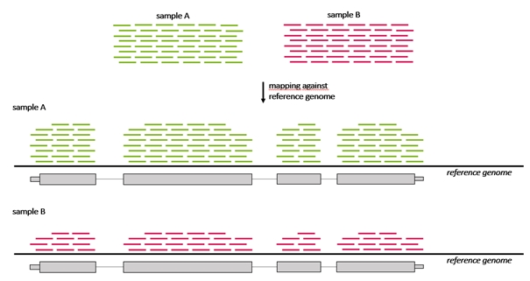
Visualizing differential expression results

Slide 12
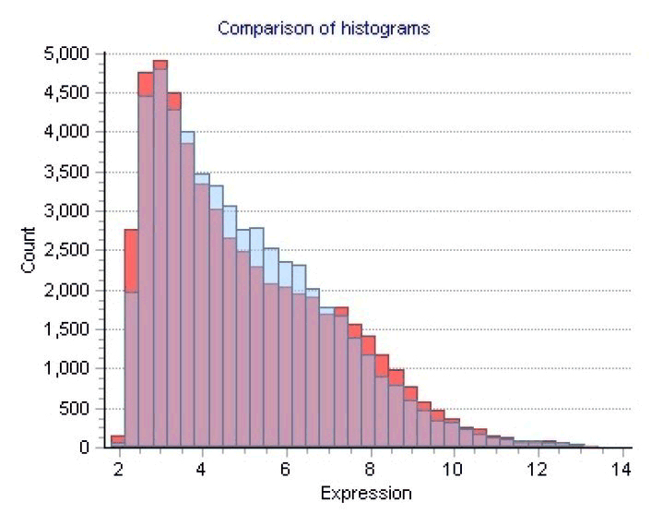
Visualizing differential expression results

Slide 13
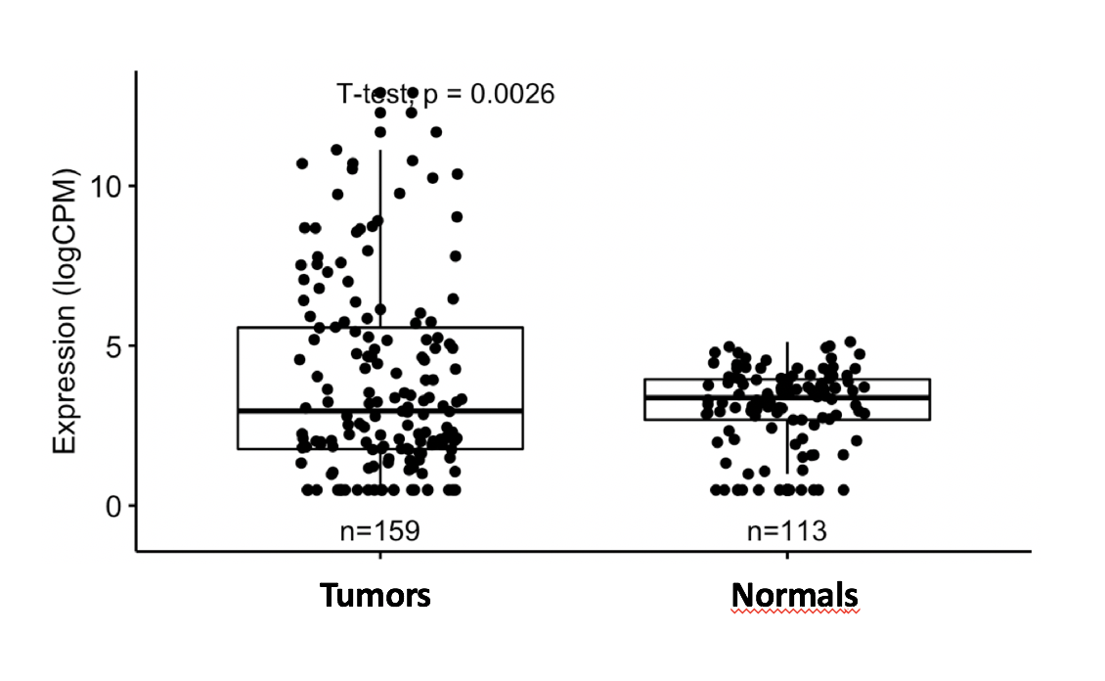
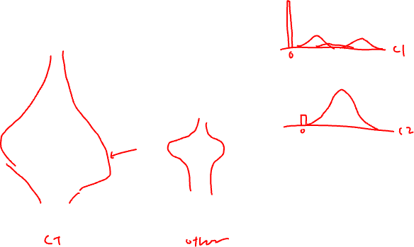
Visualizing differential expression results

Slide 14
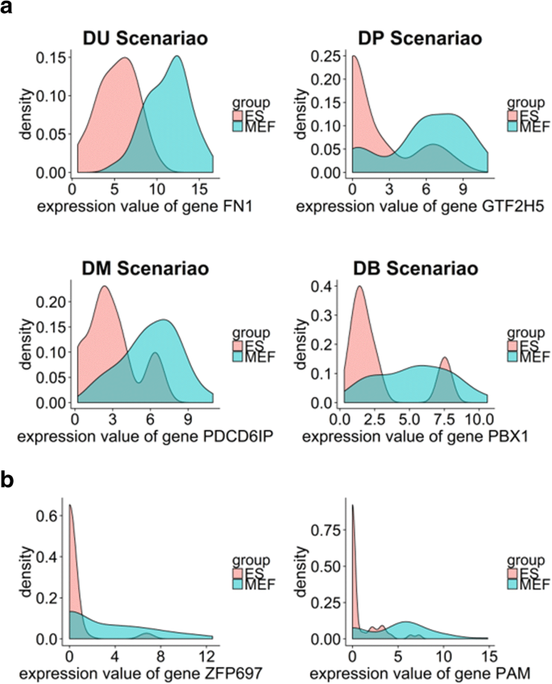
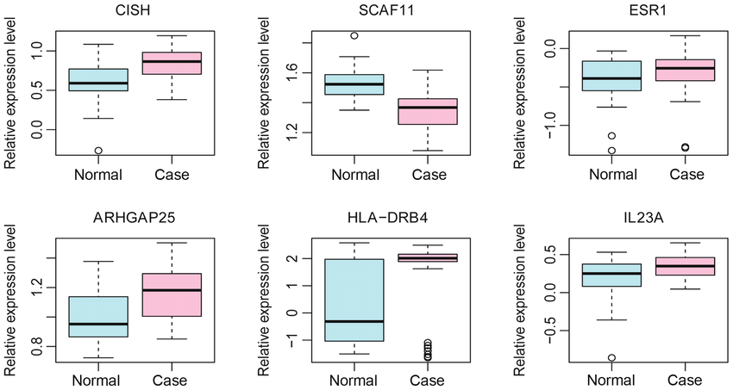
Visualizing differential expression results

Slide 15
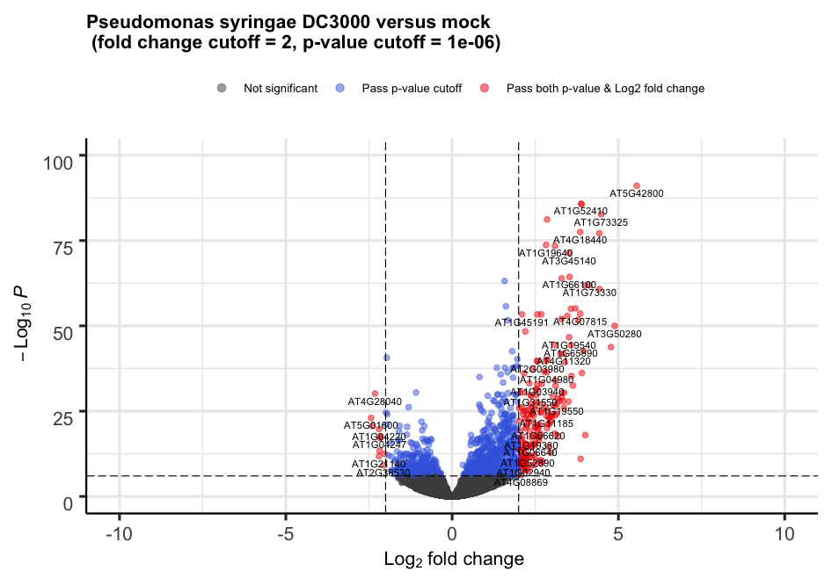
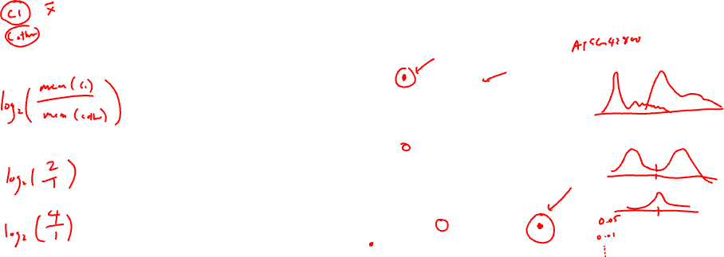
Visualizing differential expression results

Slide 16
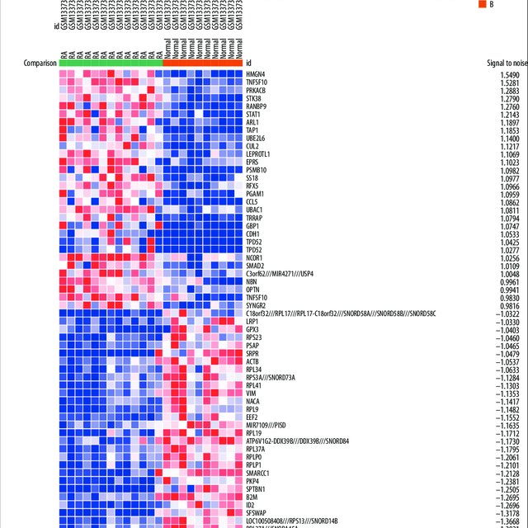
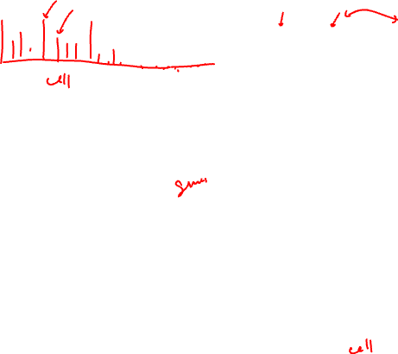
Visualizing differential expression results

Slide 17
HW5 (due Friday midnight): Create a multi-panel data visualization to interpret a cell cluster in your data
Perform kmeans clustering on your data. Pick ONE cluster and figure out what cell-type it corresponds to. Create a data visualization and write a description to convince me that your cell-type interpretation is correct.
Your multi-panel data visualization should include at minimum the following components:
A panel visualizing your one cluster of interest in reduced dimensional space (PCA, tSNE, etc)
A panel visualizing your one cluster of interest in space
A panel visualizing multiple differentially expressed genes for your cluster of interest
A panel visualizing one of these genes in reduced dimensional space (PCA, tSNE, etc)
A panel visualizing one of these genes in space
Your description should reference papers and content that allowed you to interpret your cell cluster as a particular cell-type. You must provide attribution to external resources referenced. Links are fine; formatted references are not required. (You do not need to describe the data visualization as you have been doing)
You must include the entire code you used to generate the figure so that it can be reproduced.

Slide 18
Interpreting cell-types
CD19+ CD20+ CD79A+ cell-type
Read about these genes
Read about proteins (surface proteins)

Slide 19
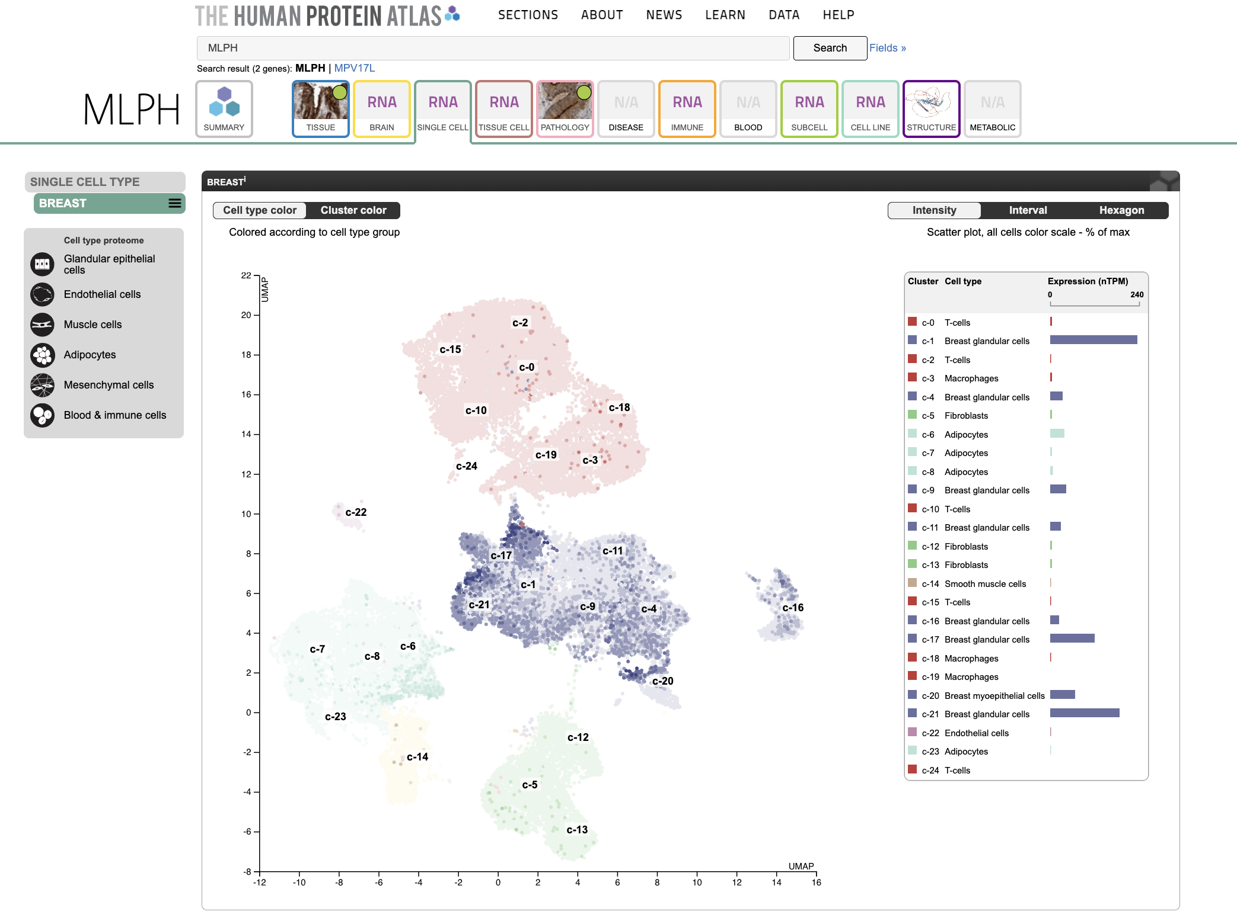
Human Protein Atlas: https://www.proteinatlas.org/

